Slide 1
Feeder Emphasis (High Vessel Recruitment)
t
e
x
t

Slide 2
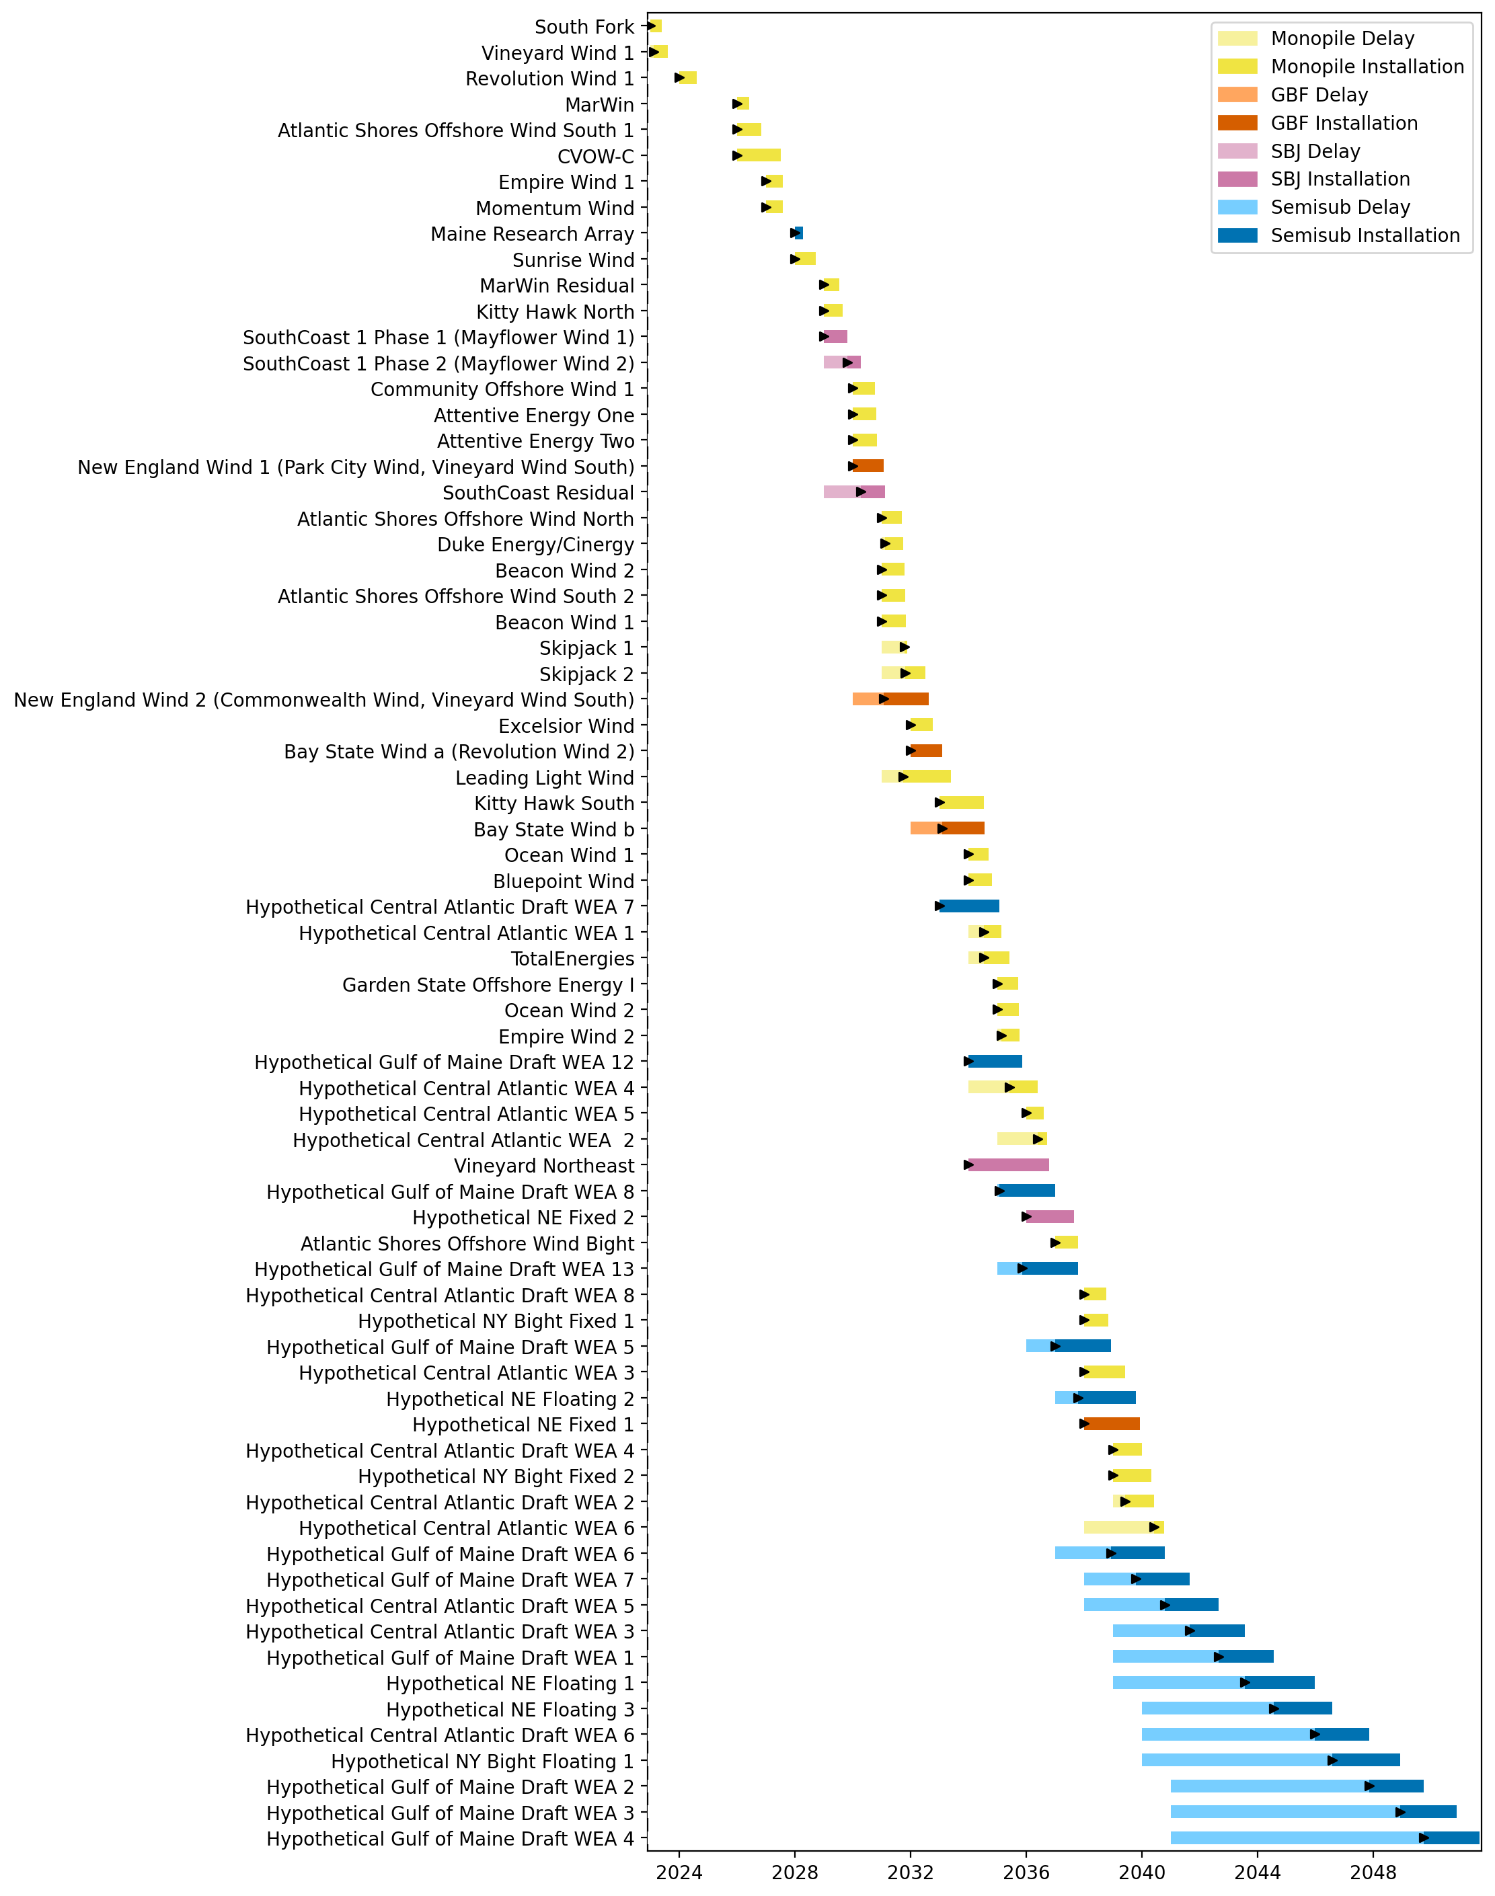
Full Gantt

Slide 3
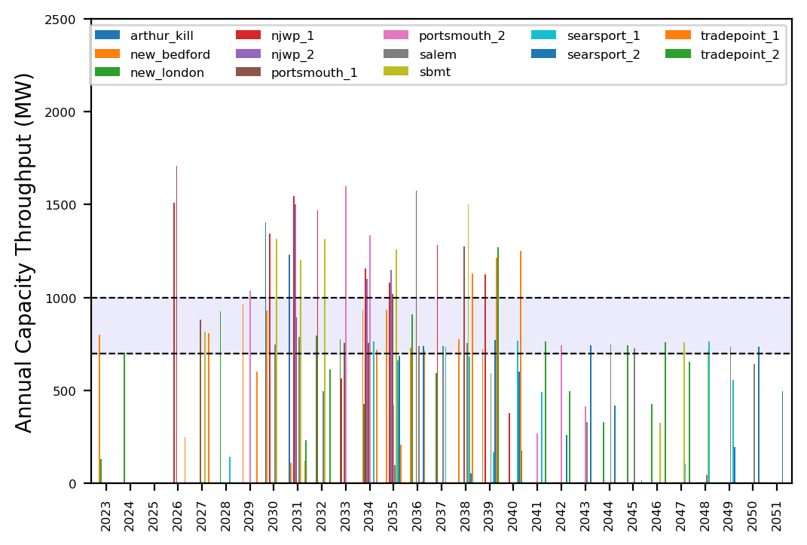
Port Throughput

Slide 4
Feeder Emphasis (Low Vessel Recruitment)
t
e
x
t

Slide 5
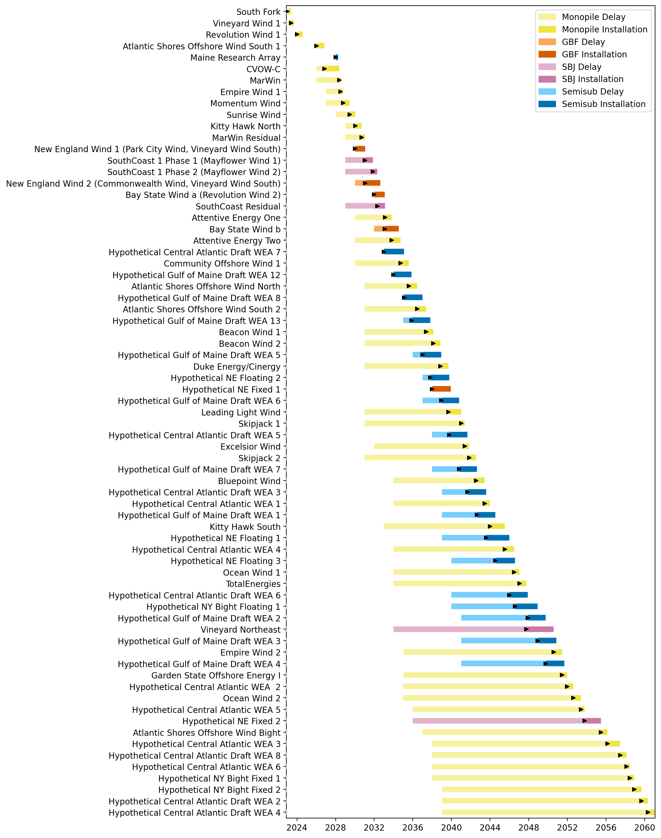
Full Gantt

Slide 6
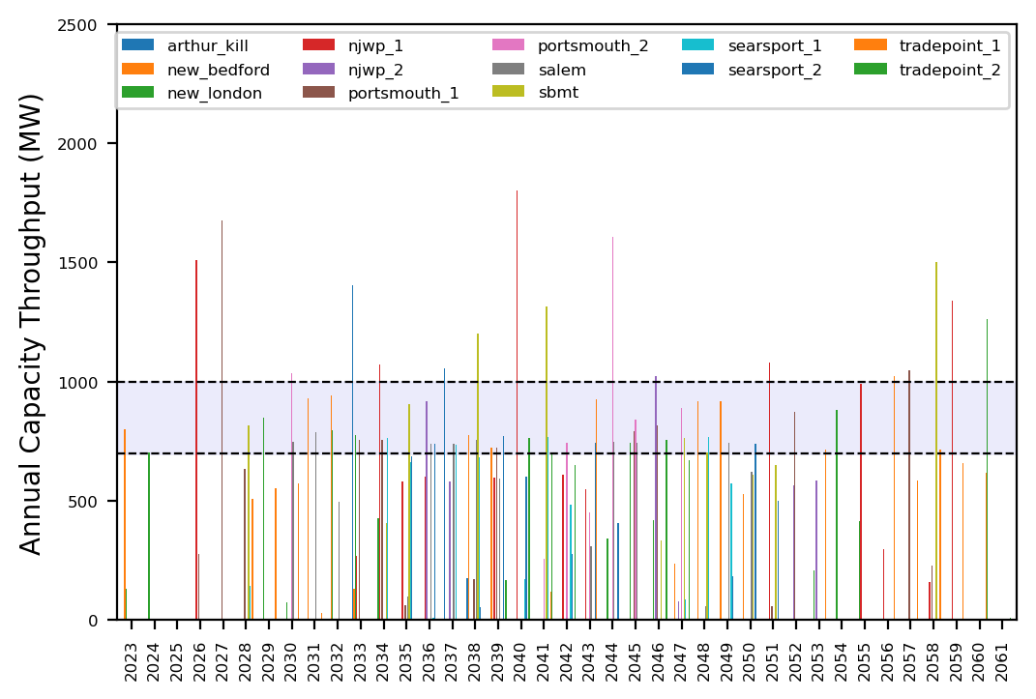
Port Throughput

Slide 7
WTIV Emphasis (Low Vessel Recruitment)
t
e
x
t

Slide 8
Full Gantt

Slide 9
Port Throughput

Slide 10
Hybrid
t
e
x
t

Slide 11
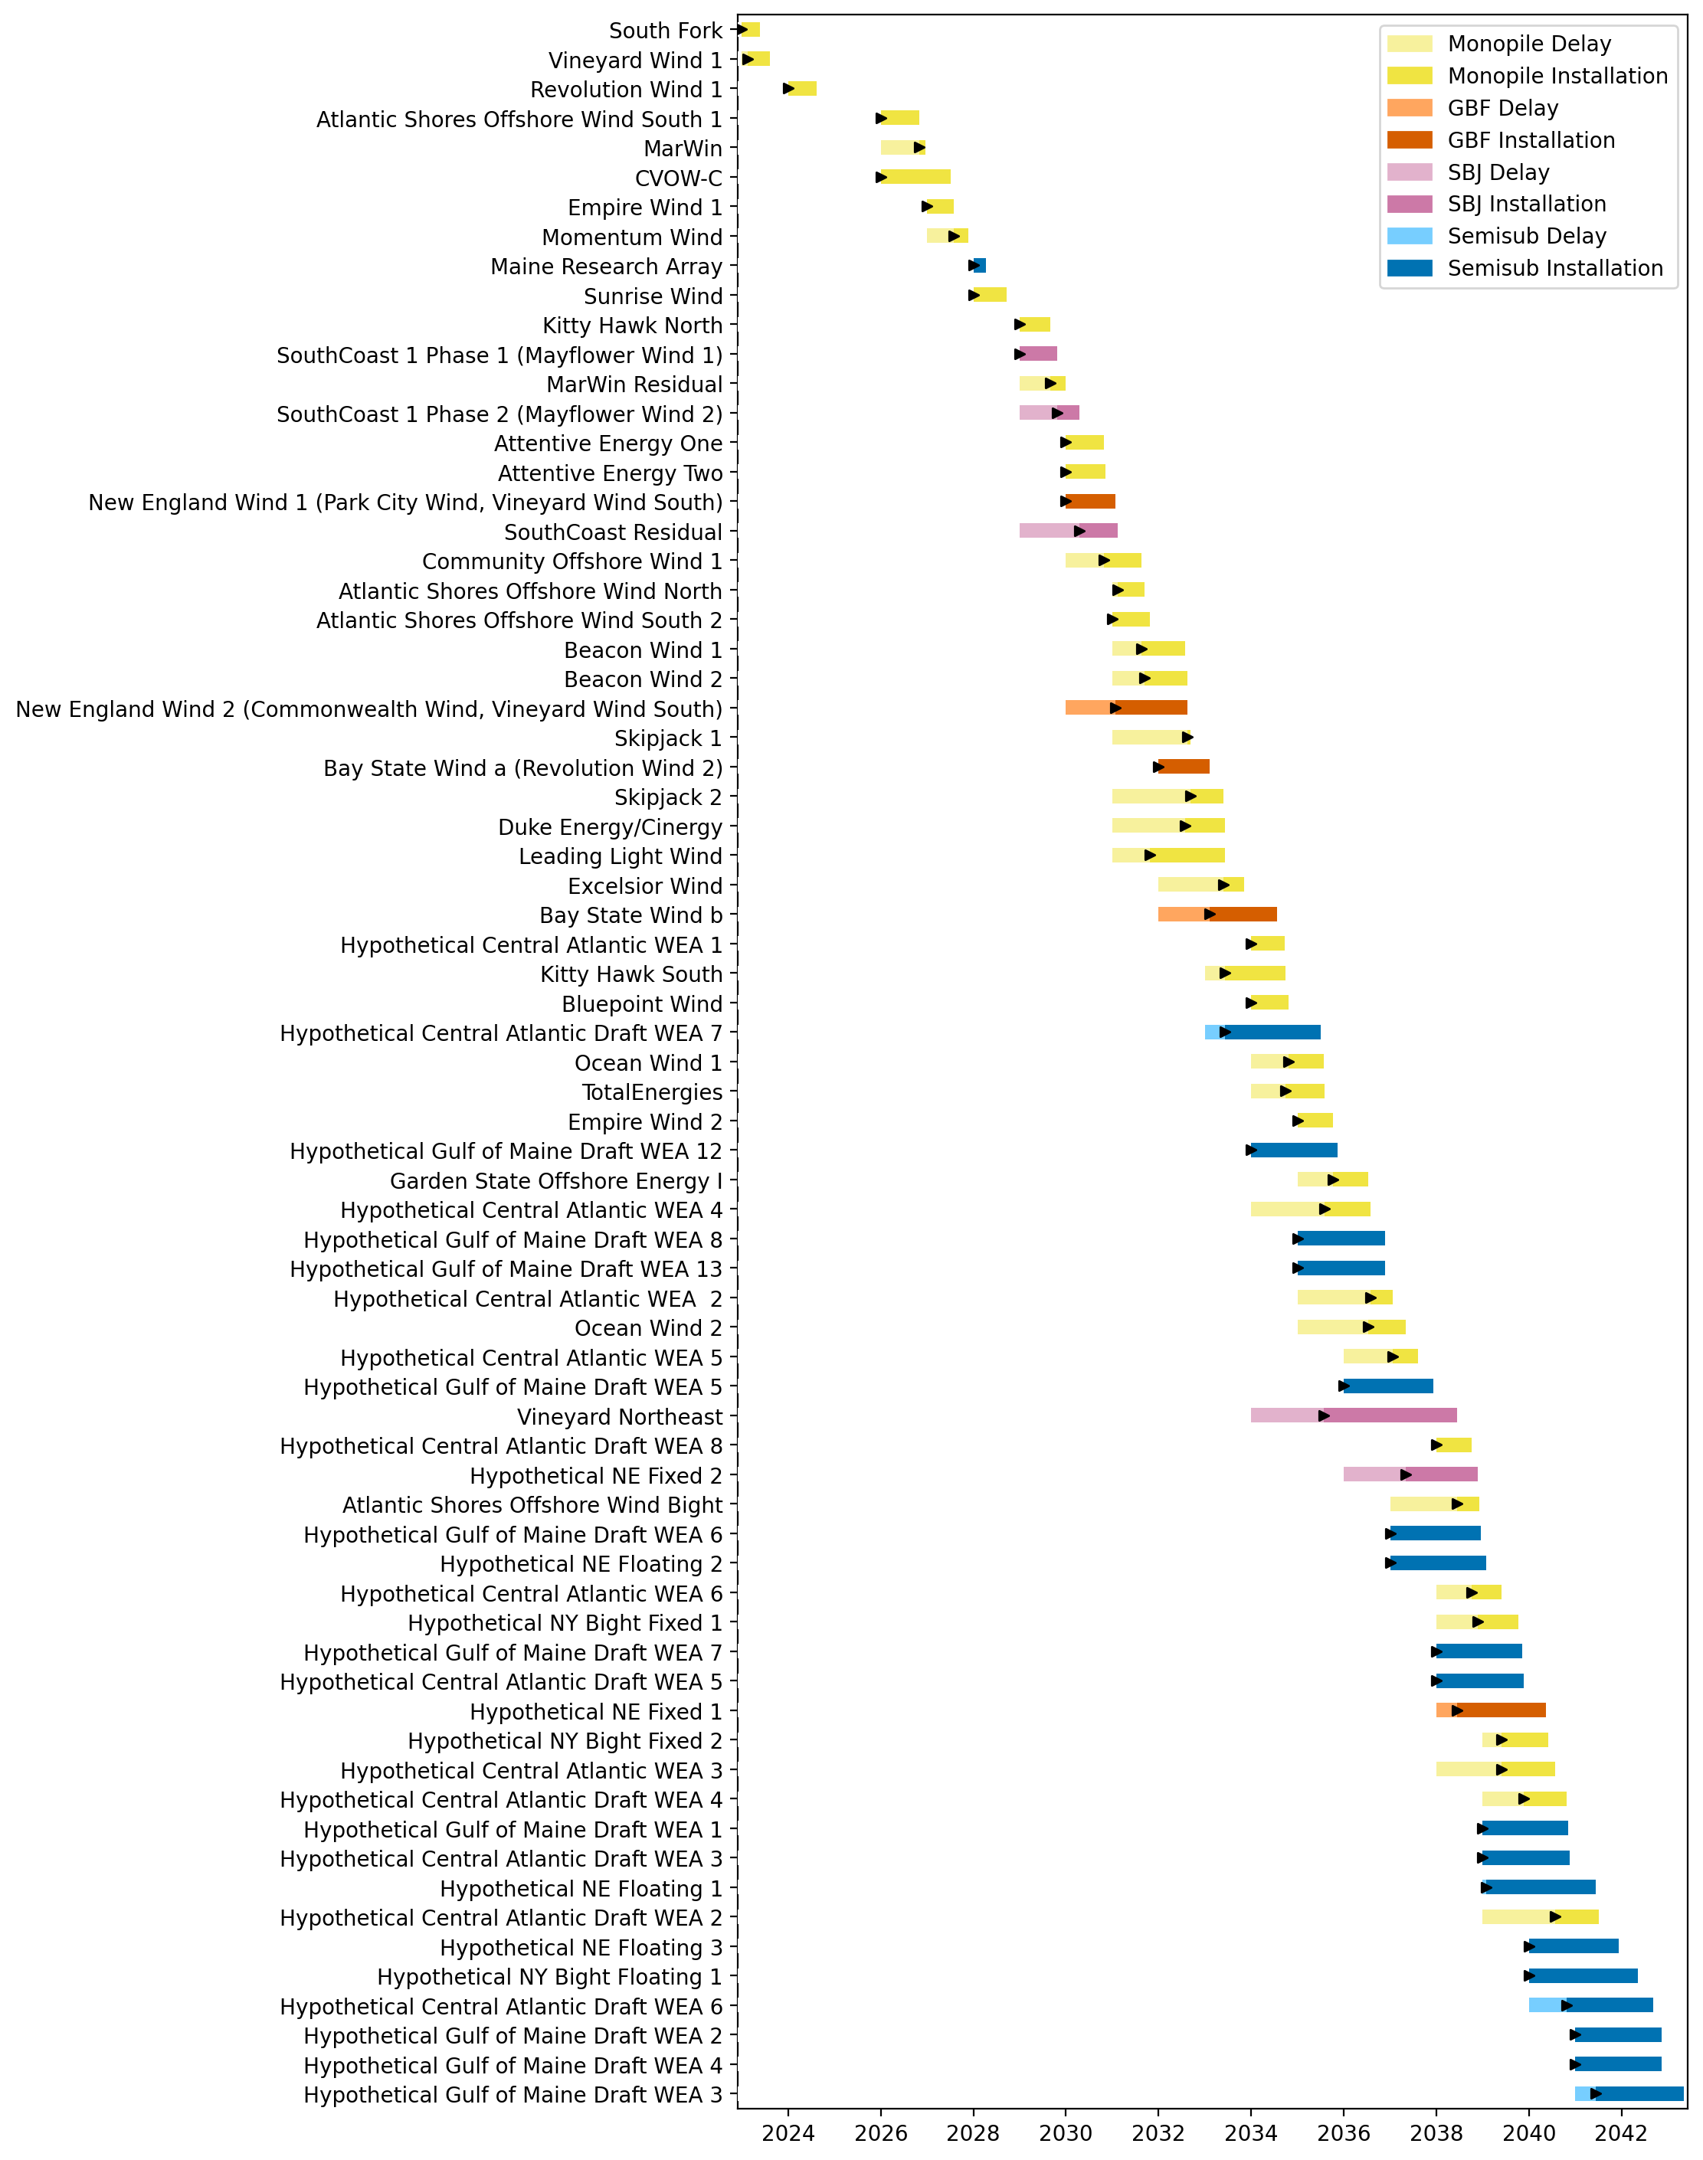
Full Gantt

Slide 12
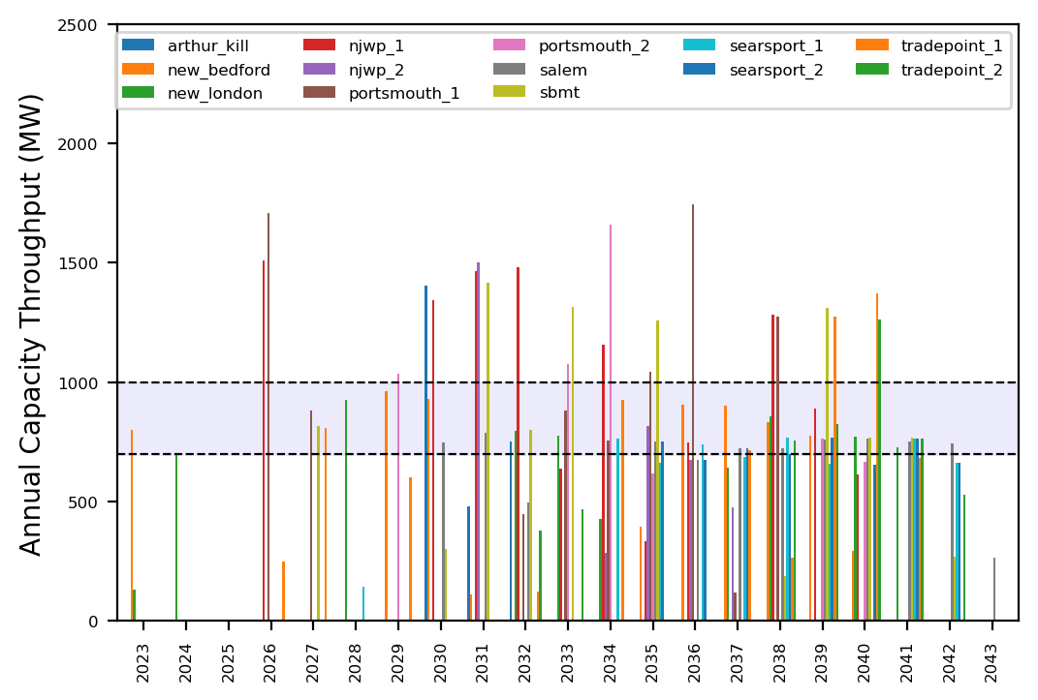
Port Throughput

Slide 13
No Action
t
e
x
t

Slide 14
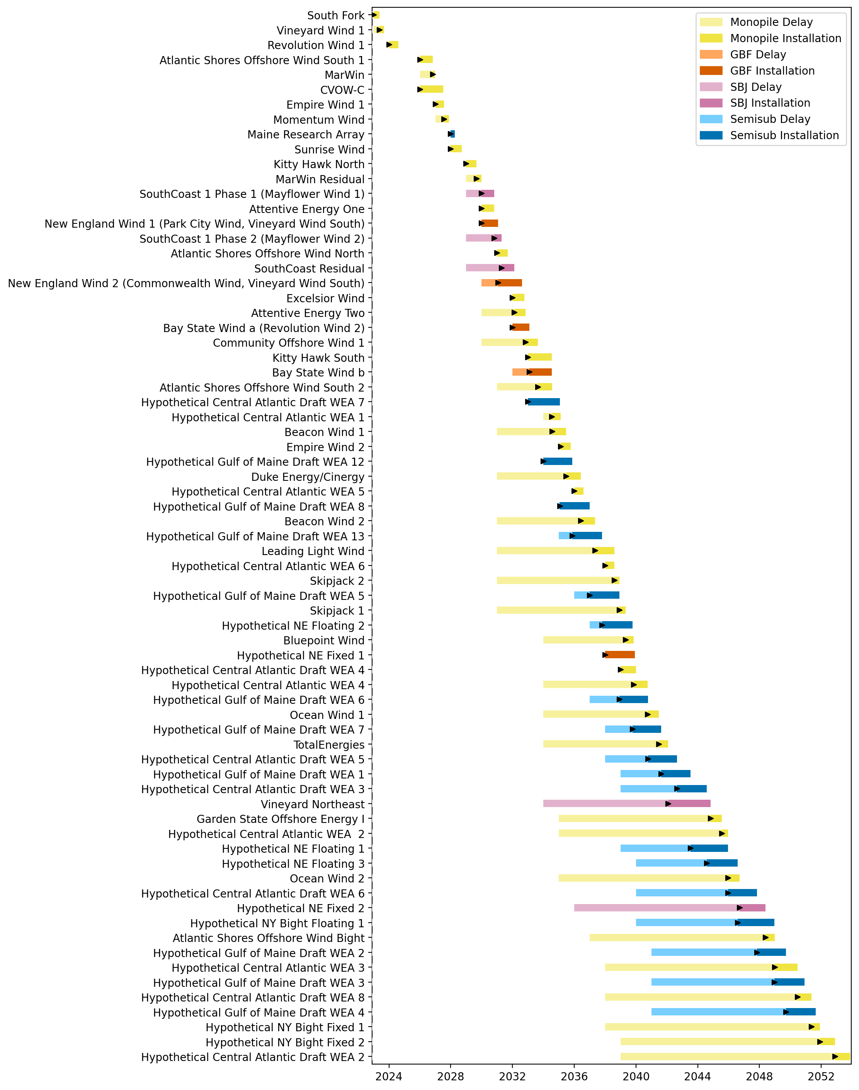
Full Gantt

Slide 15
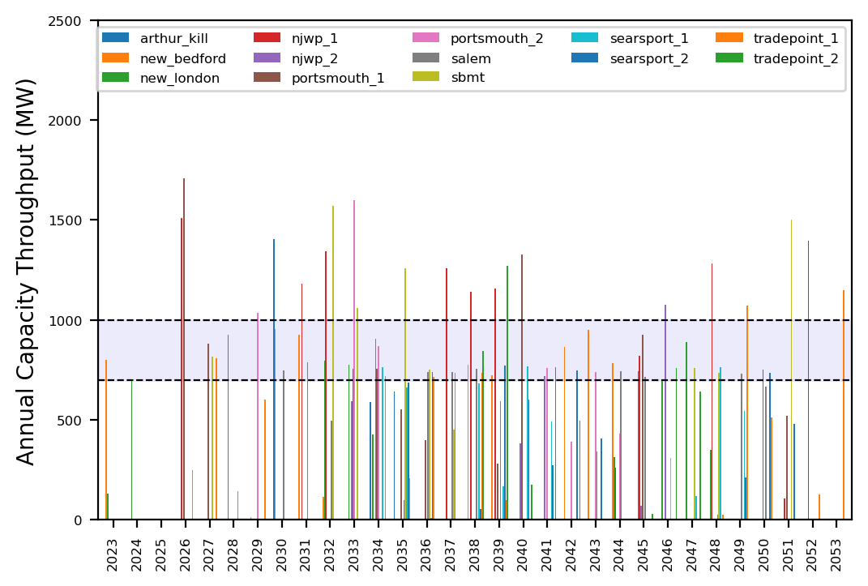
Port Throughput

Slide 16
AHTS Emphasis GBFs
t
e
x
t

Slide 17
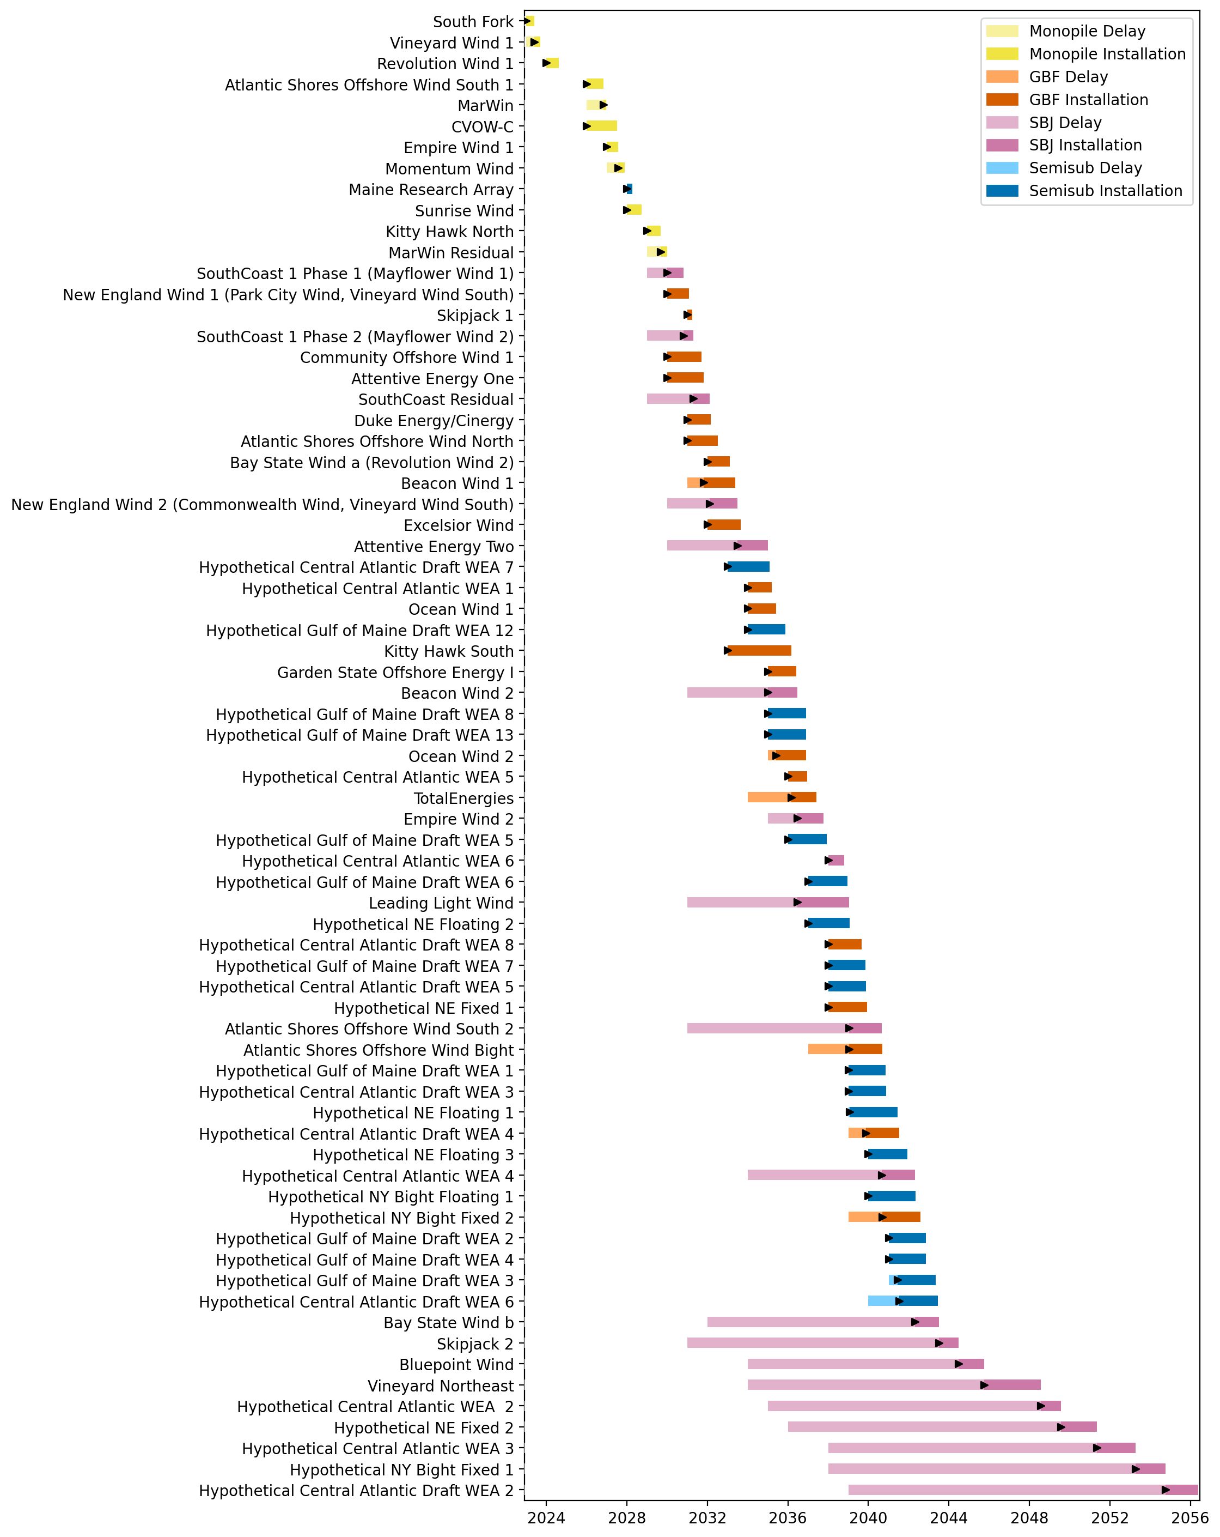
Full Gantt

Slide 18
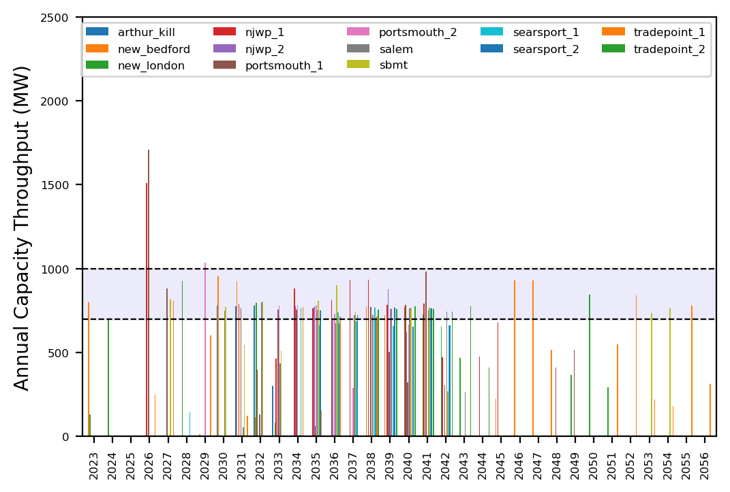
Port Throughput

Slide 19
Infinite Vessels
t
e
x
t

Slide 20
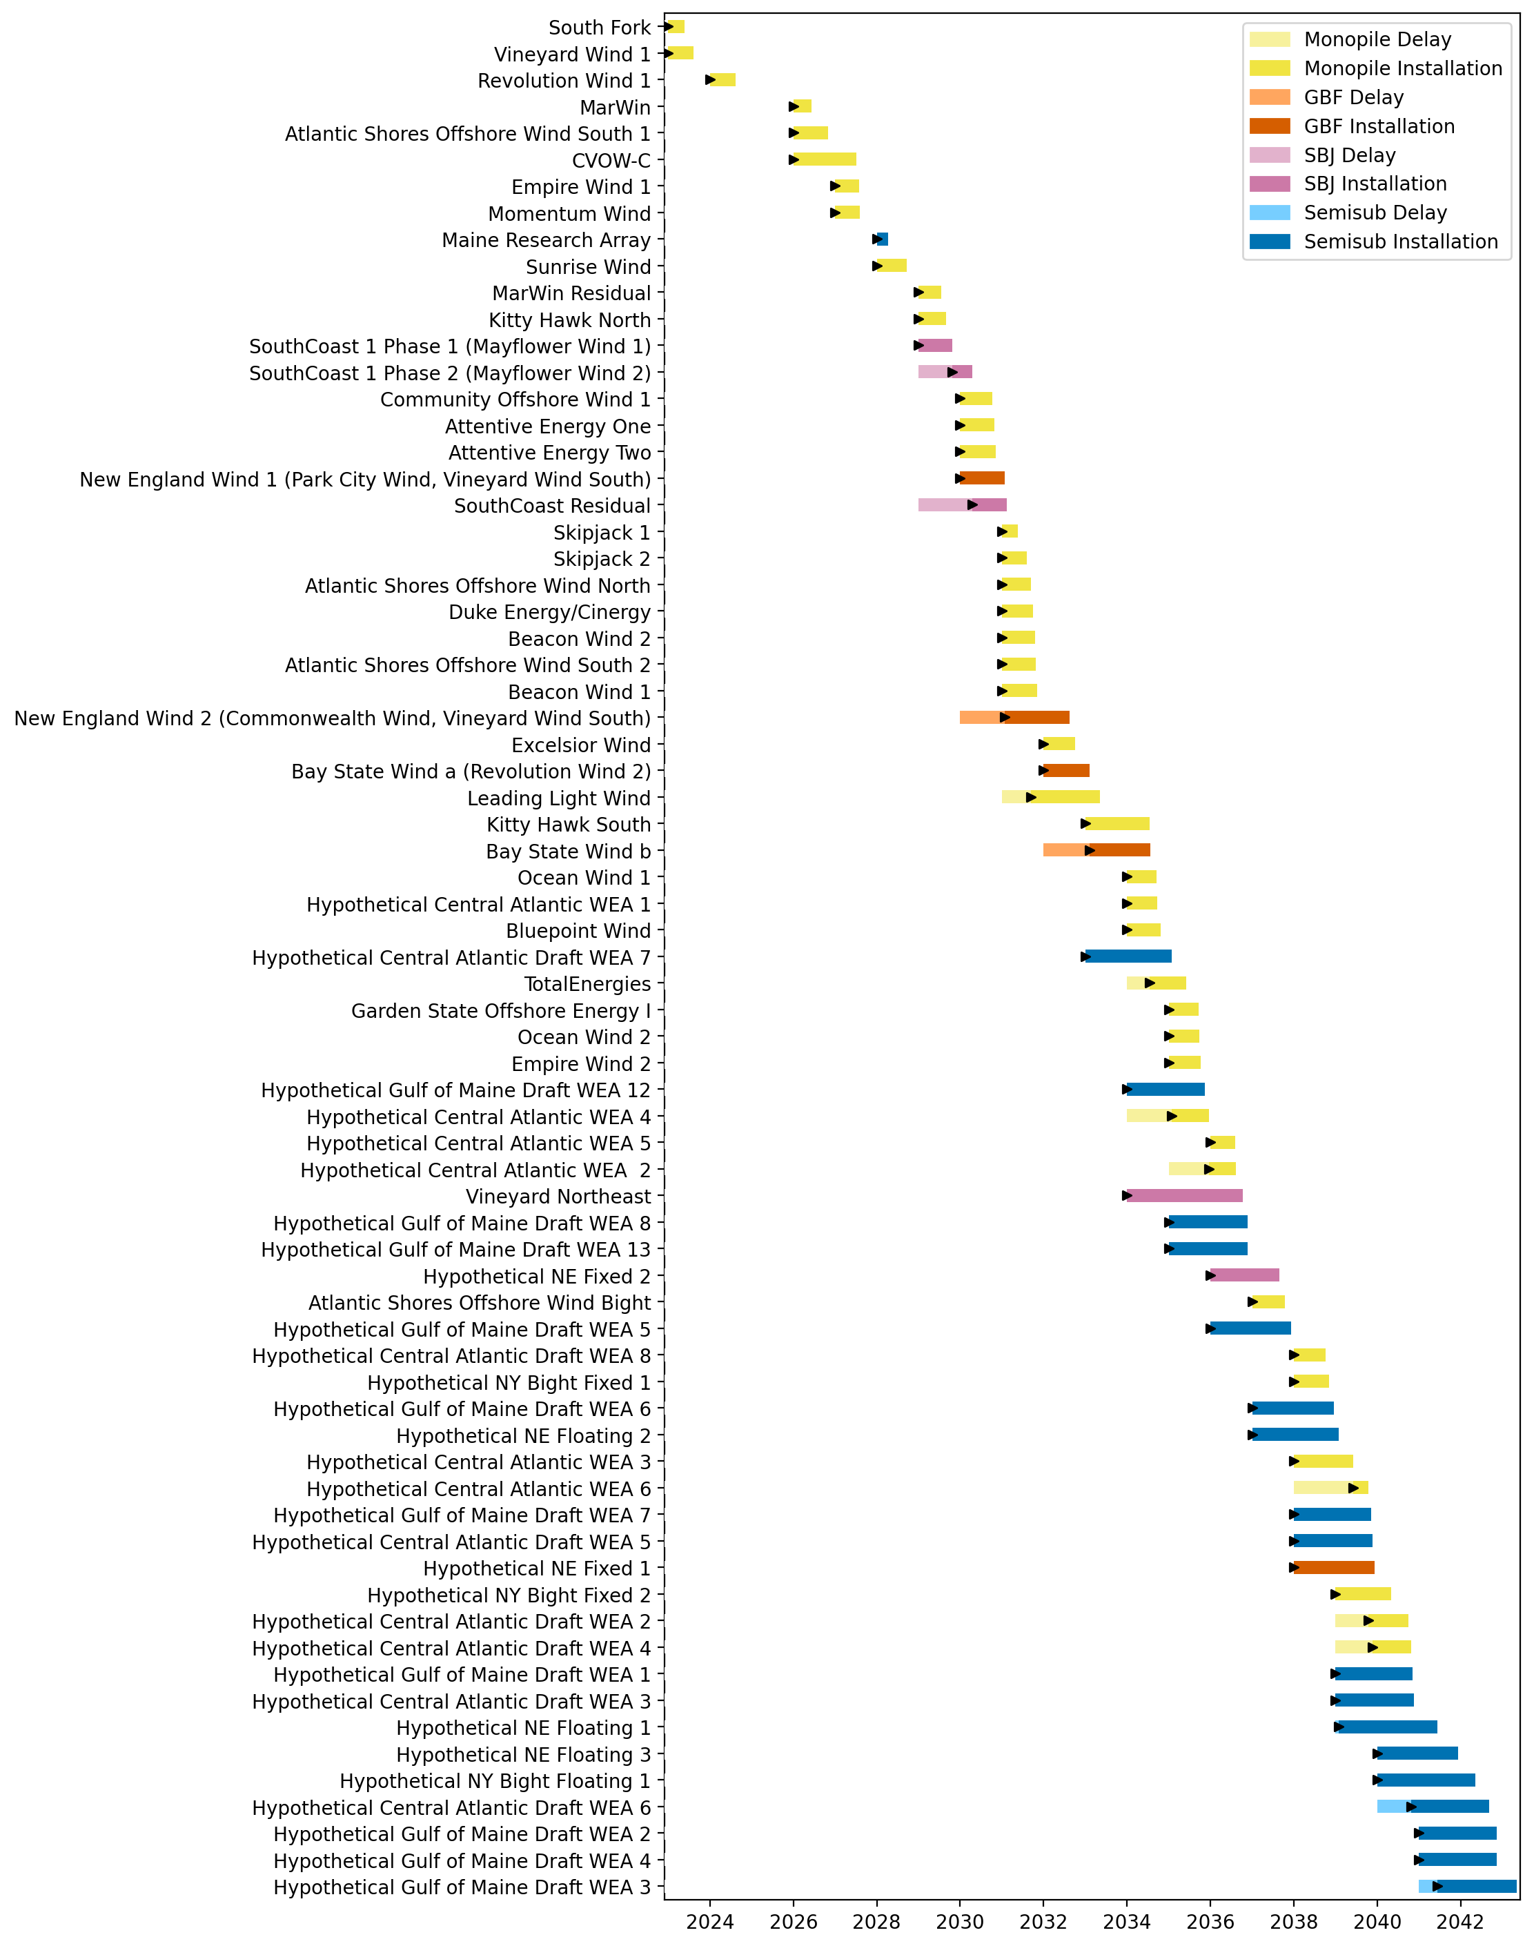
Full Gantt

Slide 21
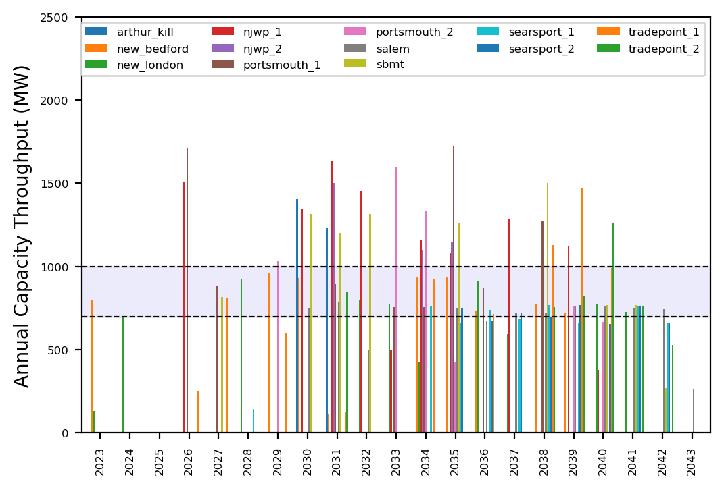
Port Throughput

Slide 22
WTIV Emphasis
t
e
x
t

Slide 23
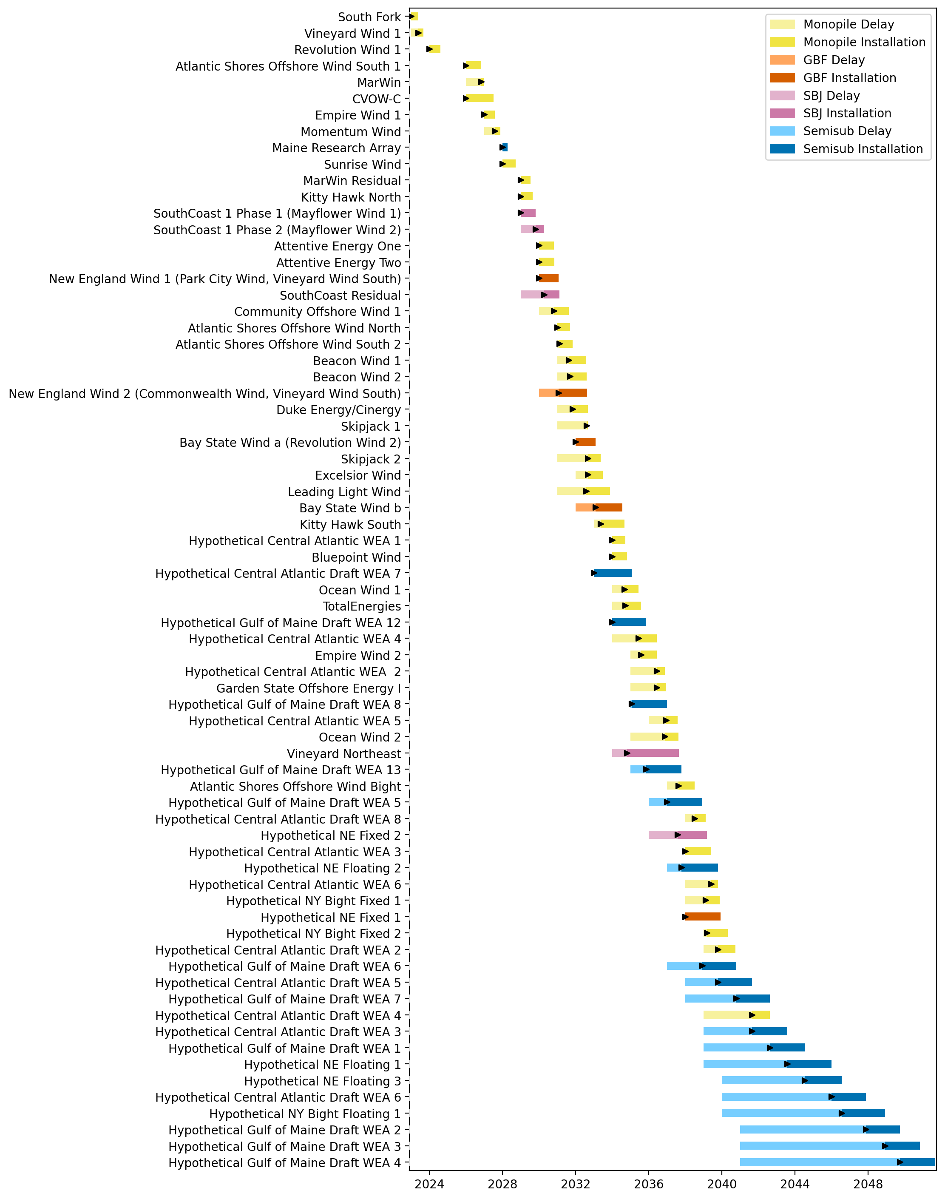
Full Gantt

Slide 24
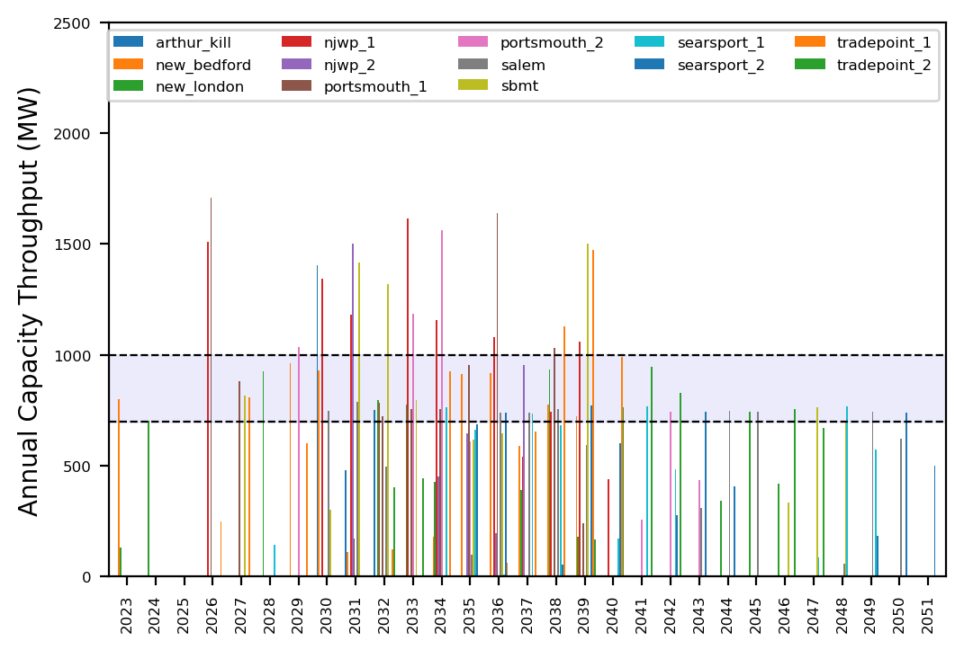
Port Throughput

Slide 25
AHTS Emphasis
t
e
x
t

Slide 26
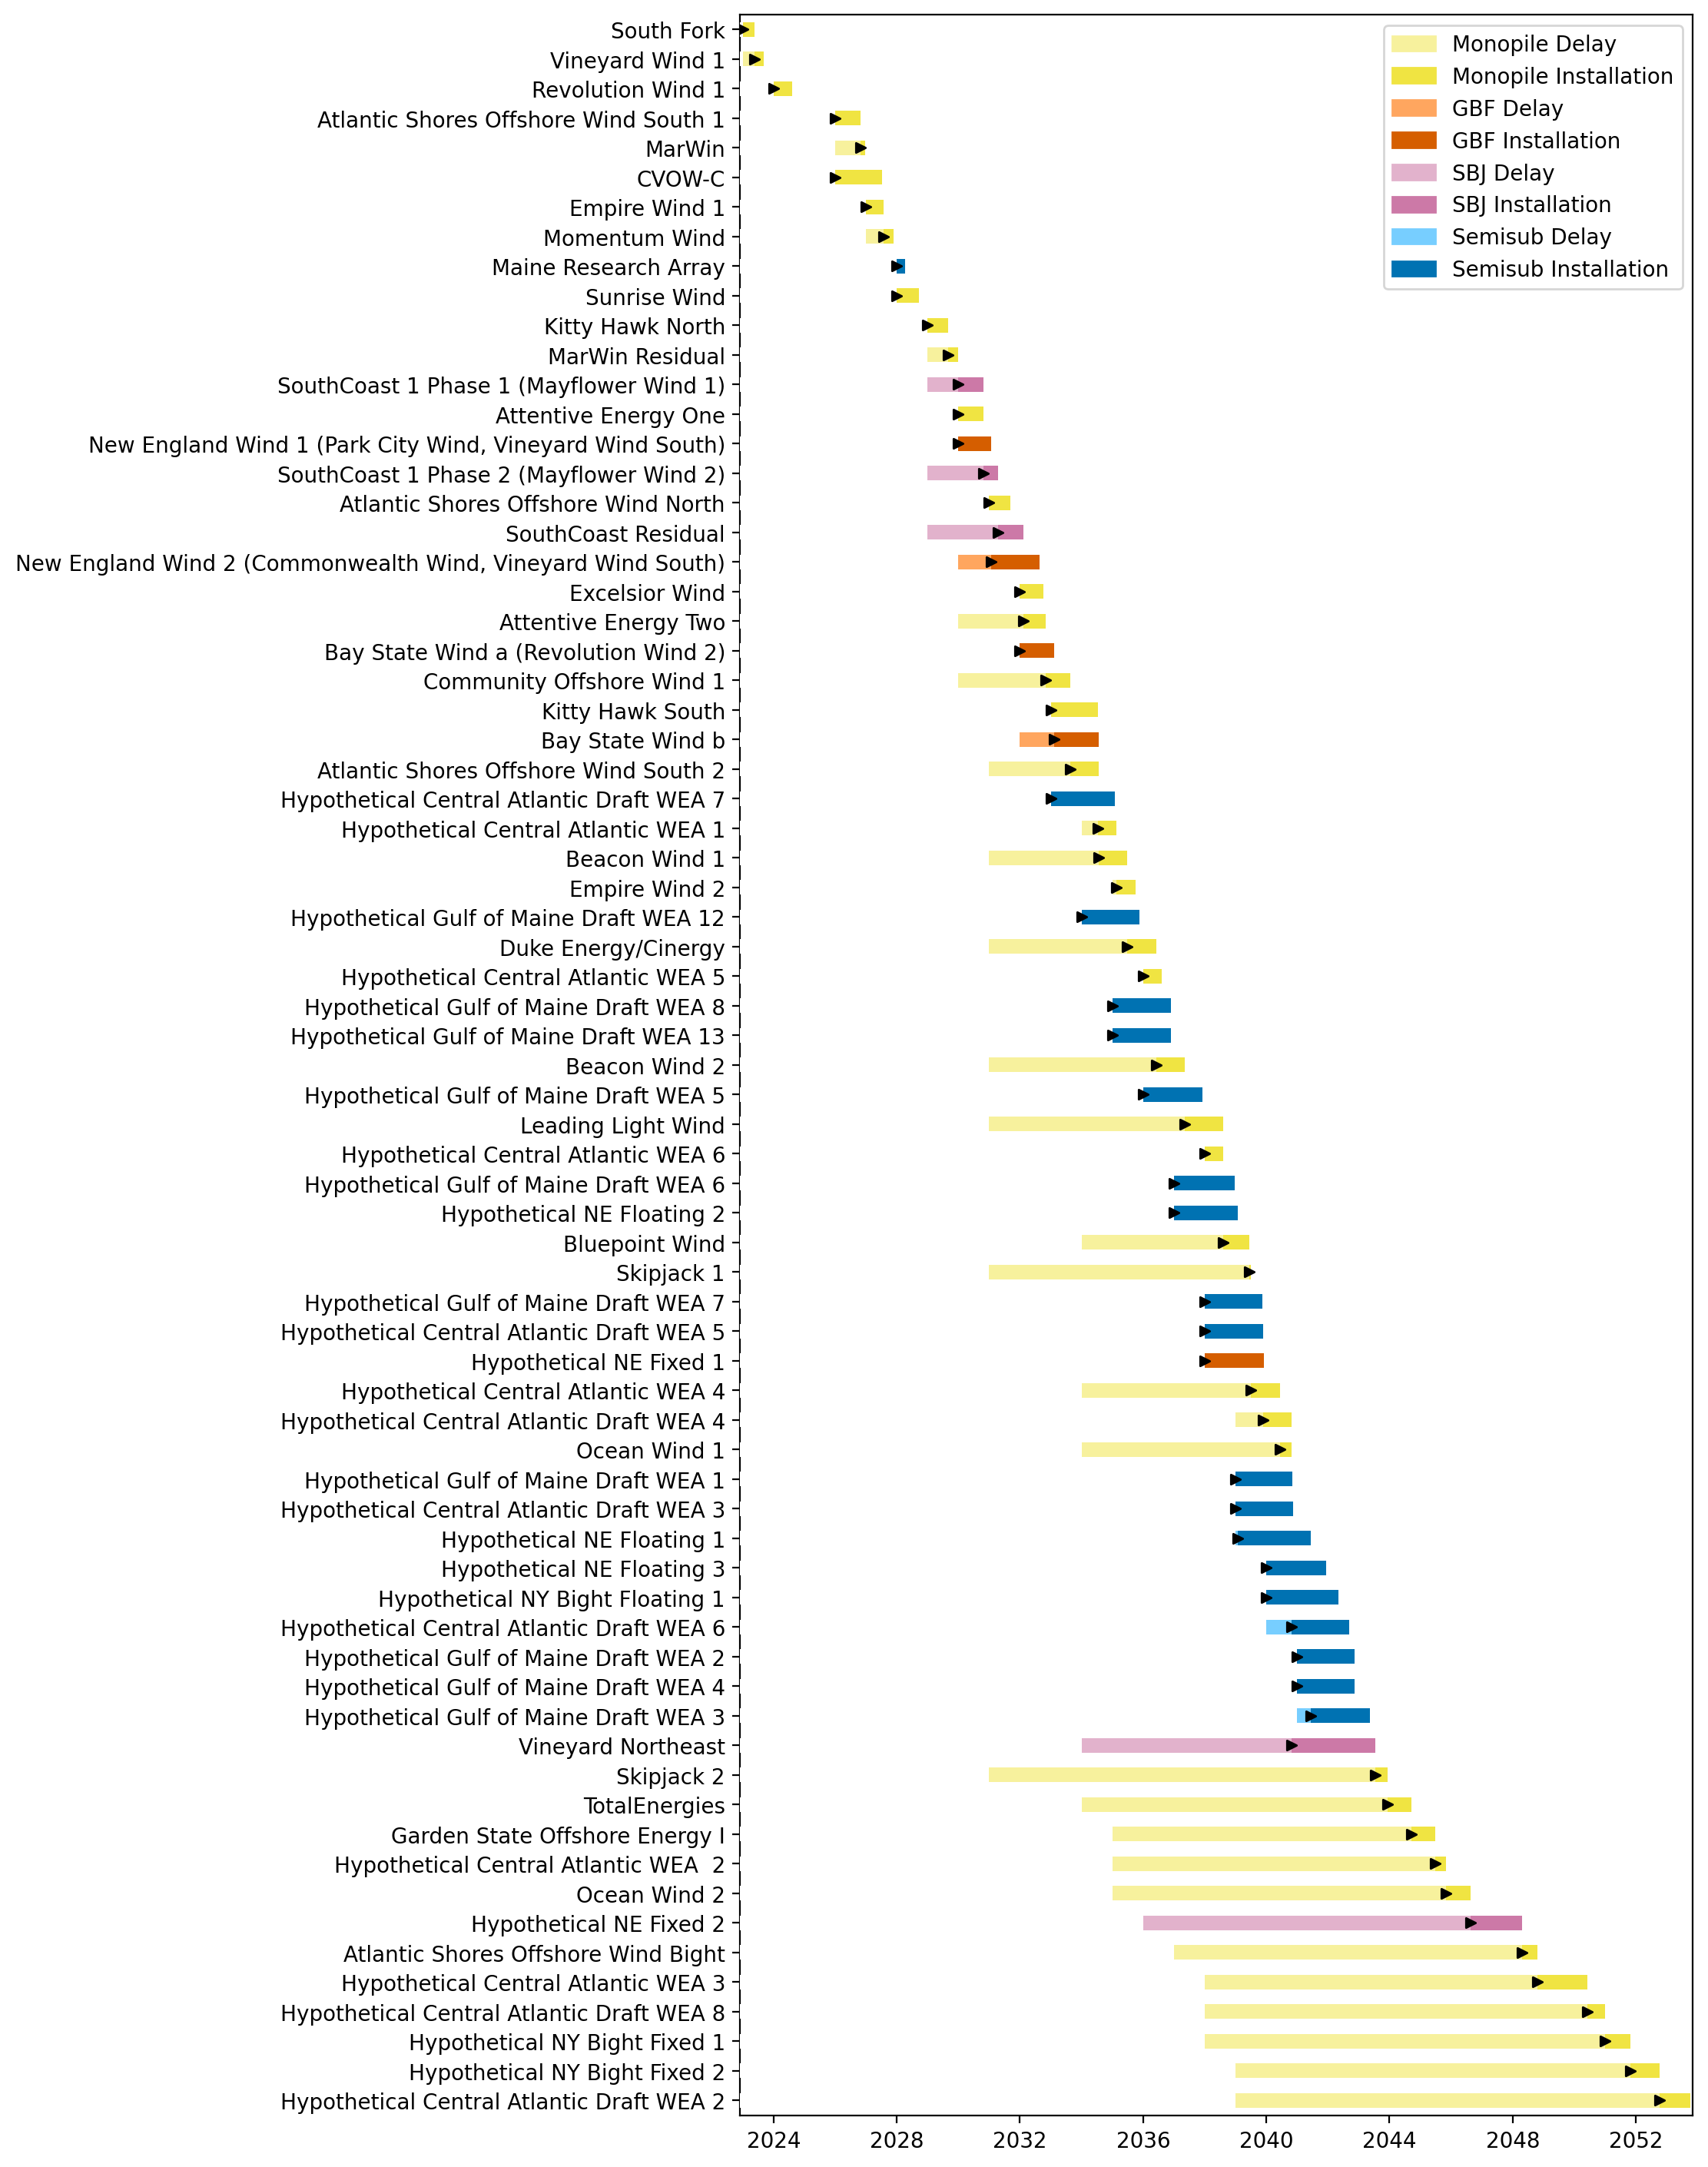
Full Gantt

Slide 27
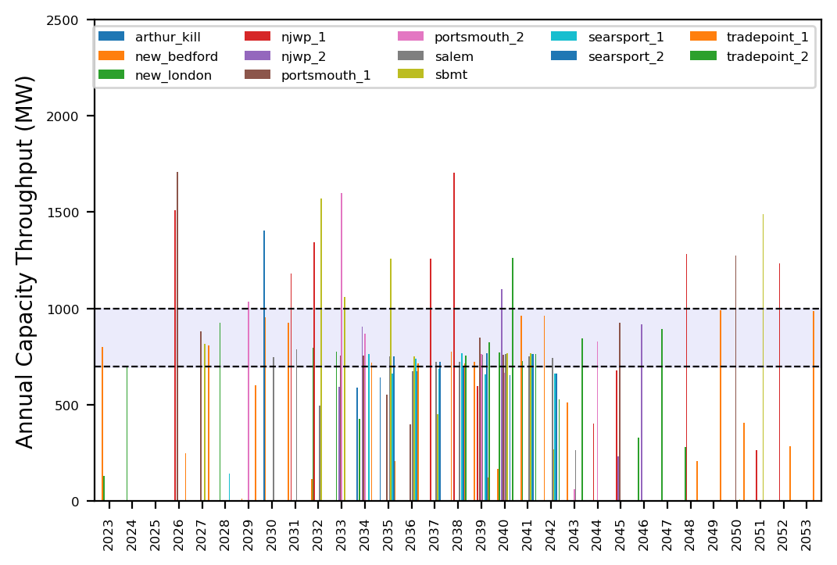
Port Throughput

Slide 28
Hybrid (Low Vessel Recruitment)
t
e
x
t

Slide 29
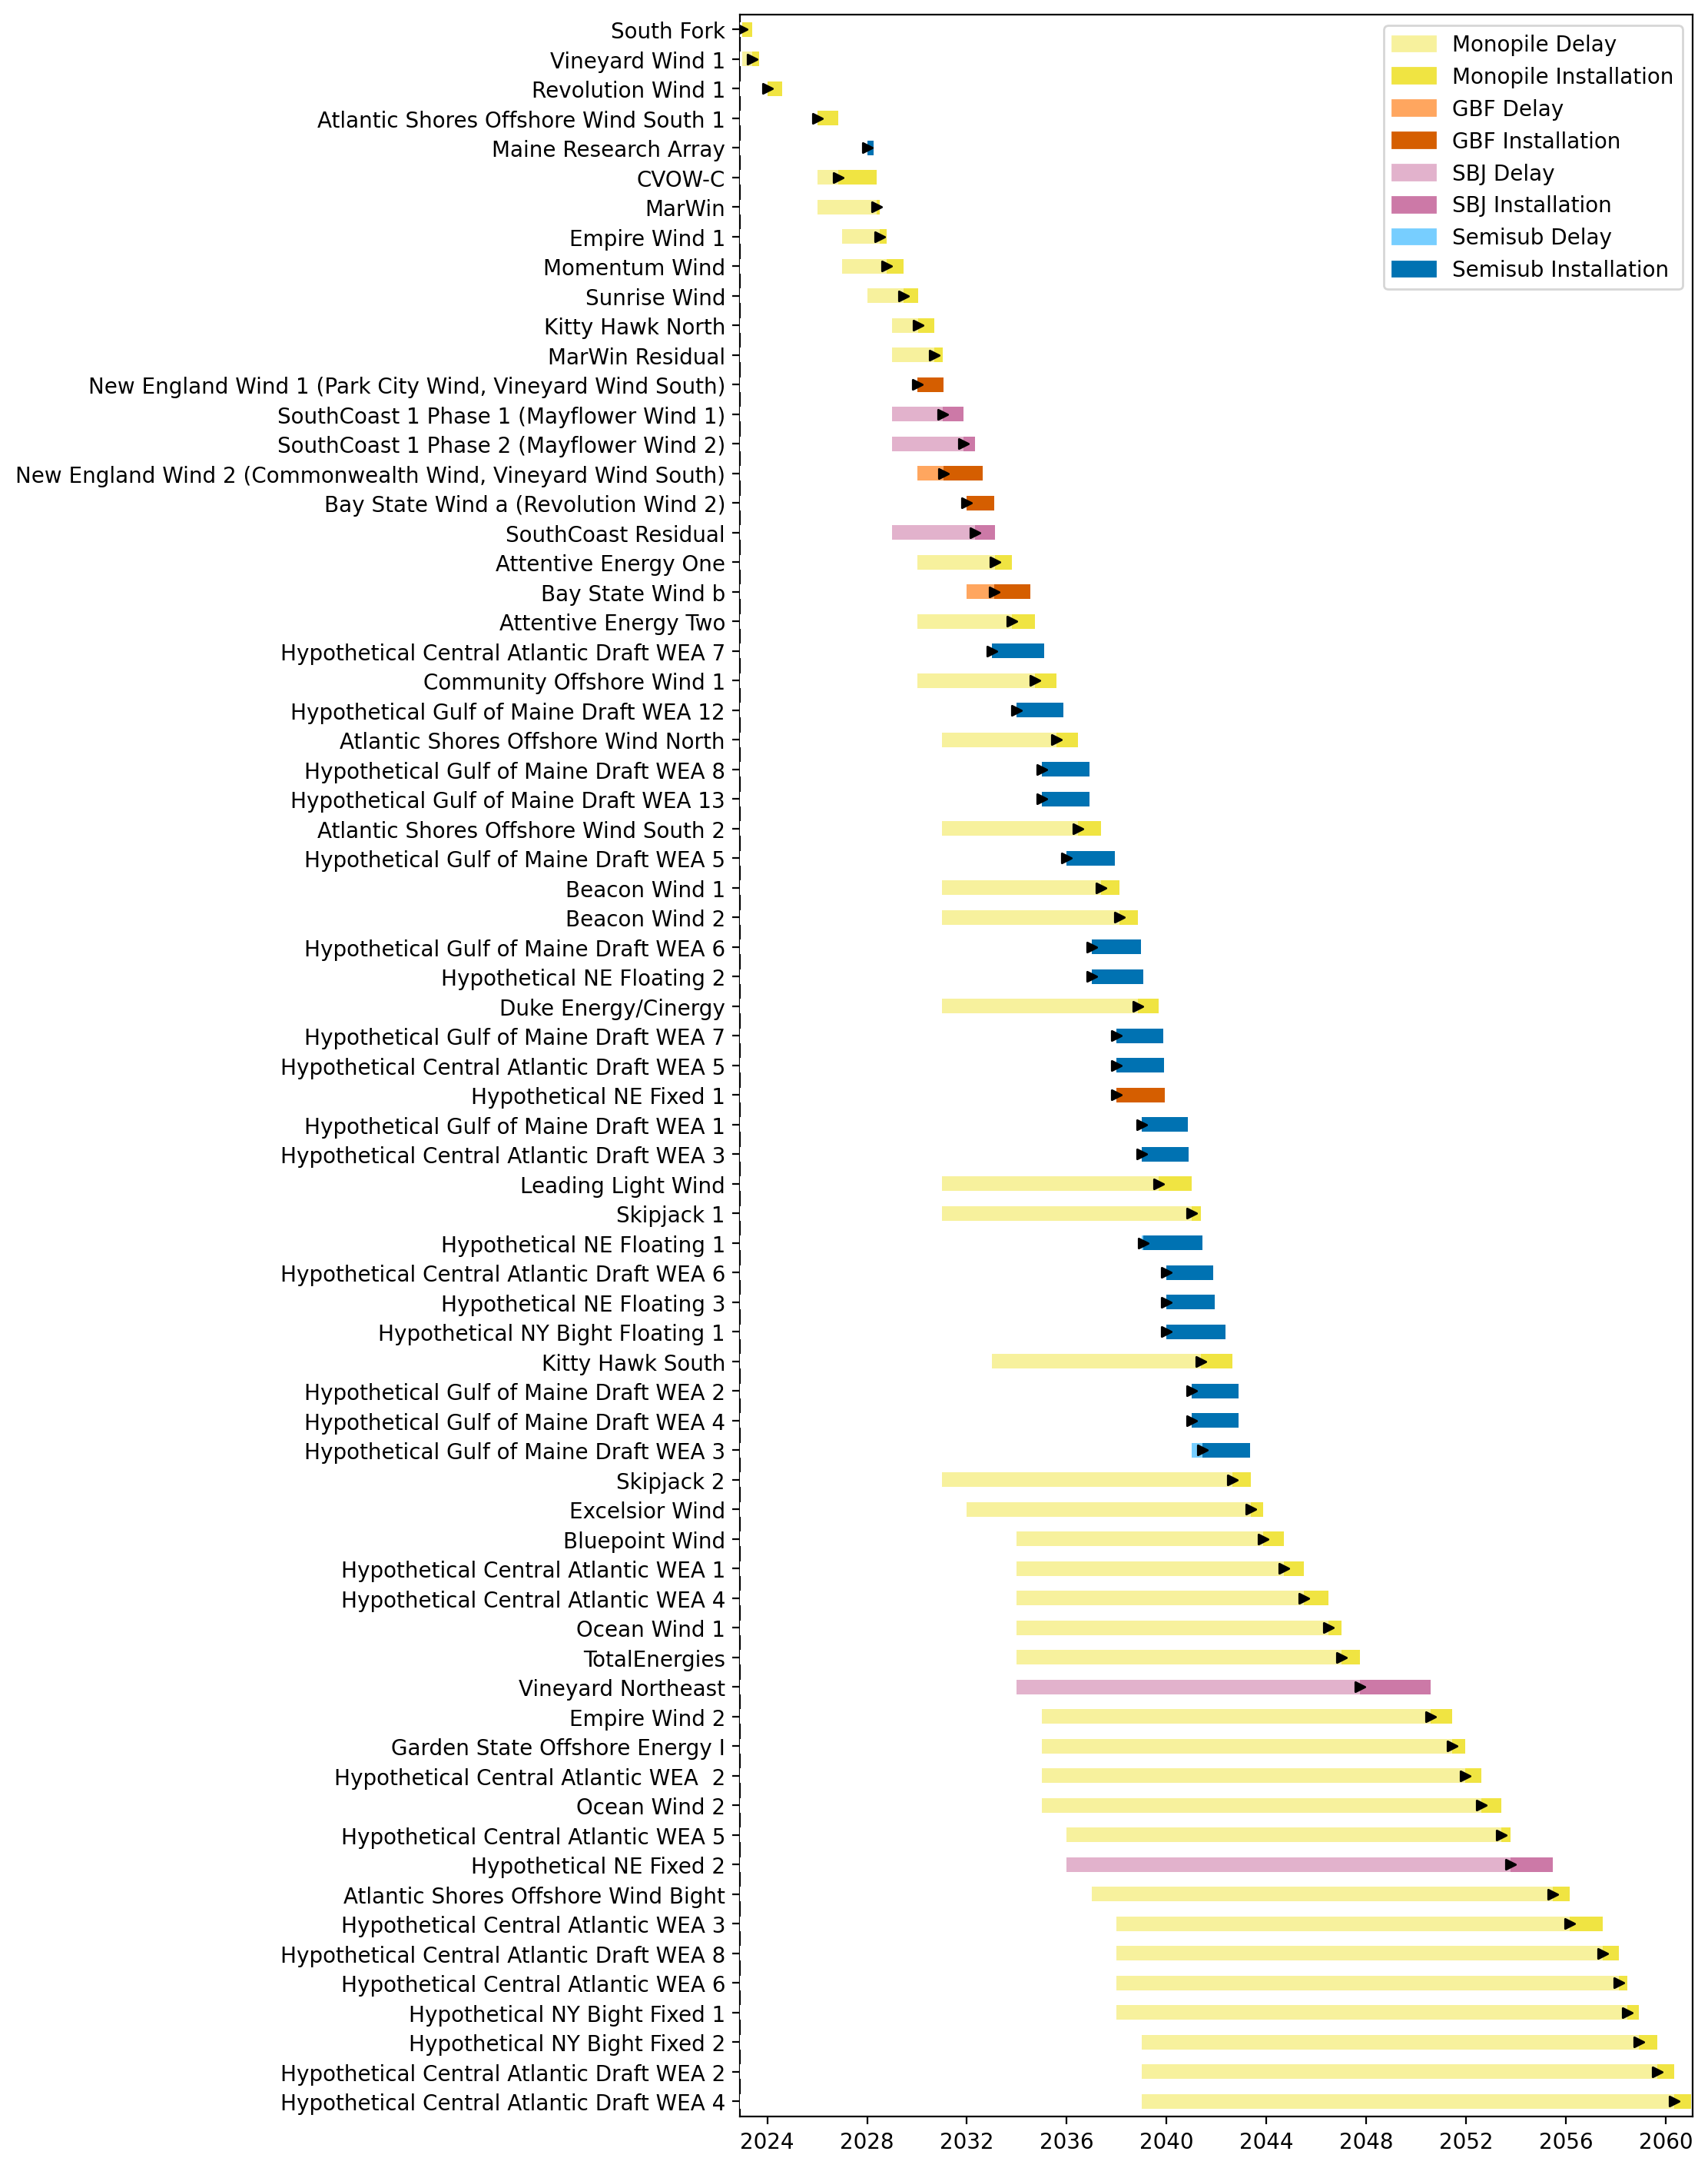
Full Gantt

Slide 30
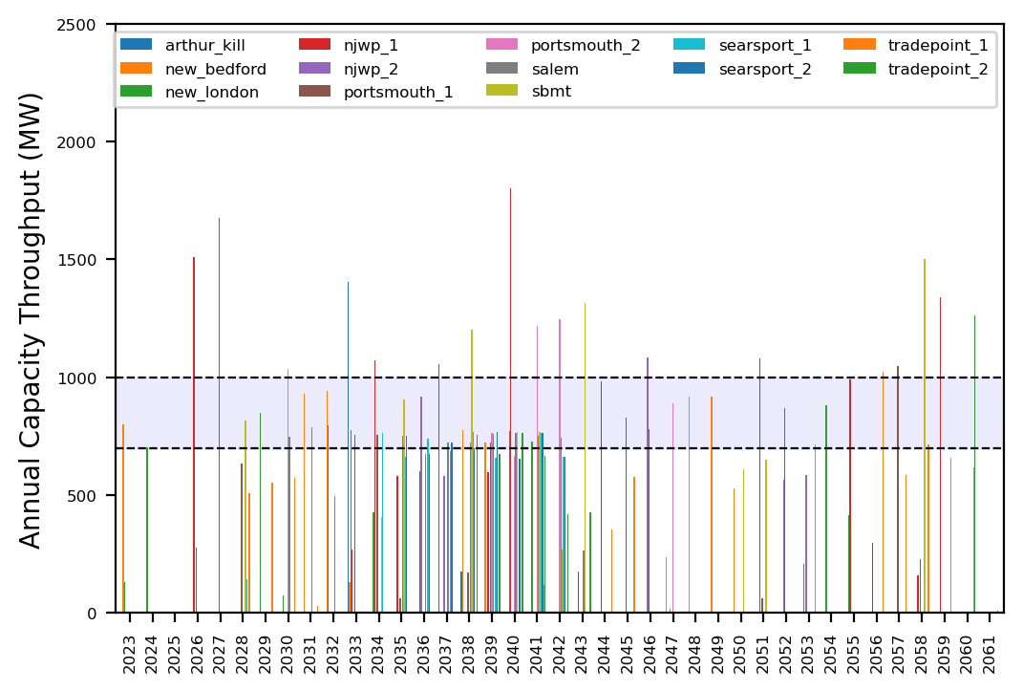
Port Throughput

Slide 31
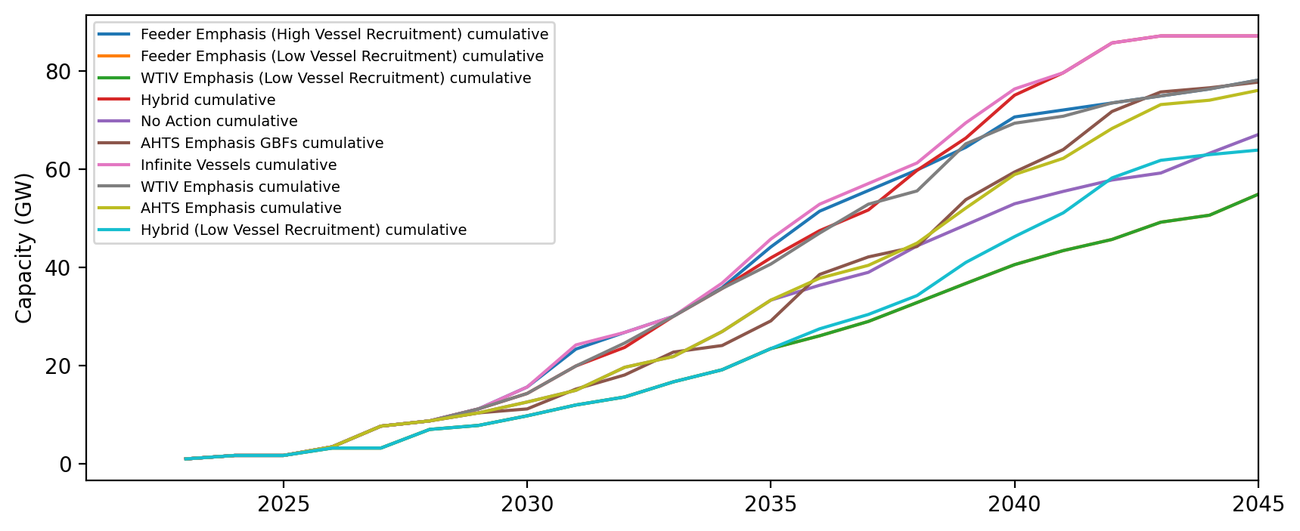
Installed Capacity

Slide 32
Installed Capacity - All Regions

Slide 33
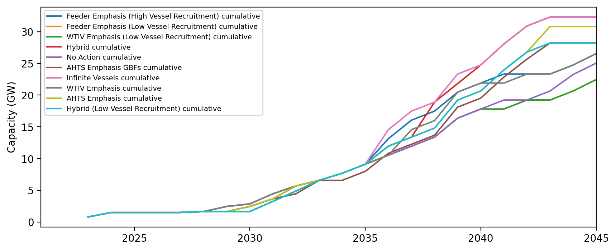
Installed Capacity - NE

Slide 34
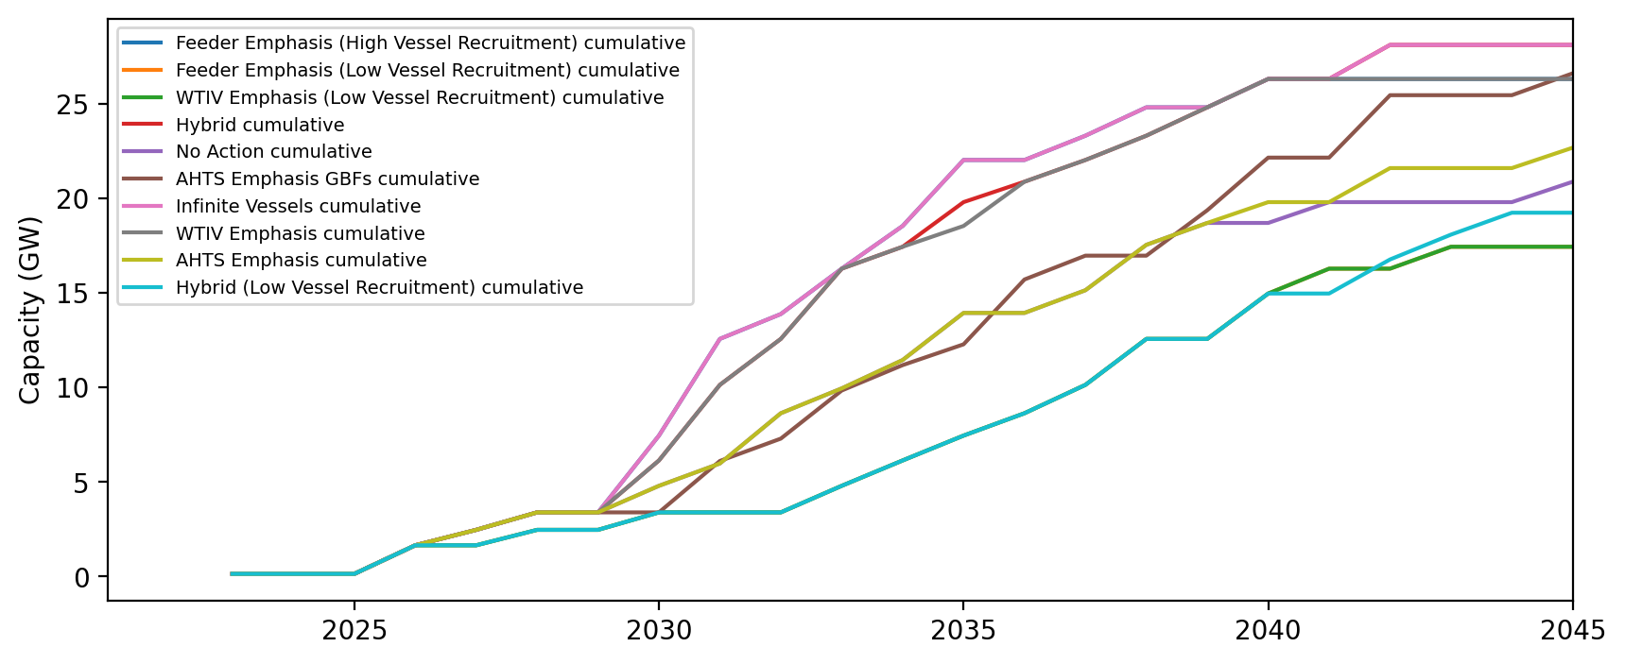
Installed Capacity - NYNJ

Slide 35
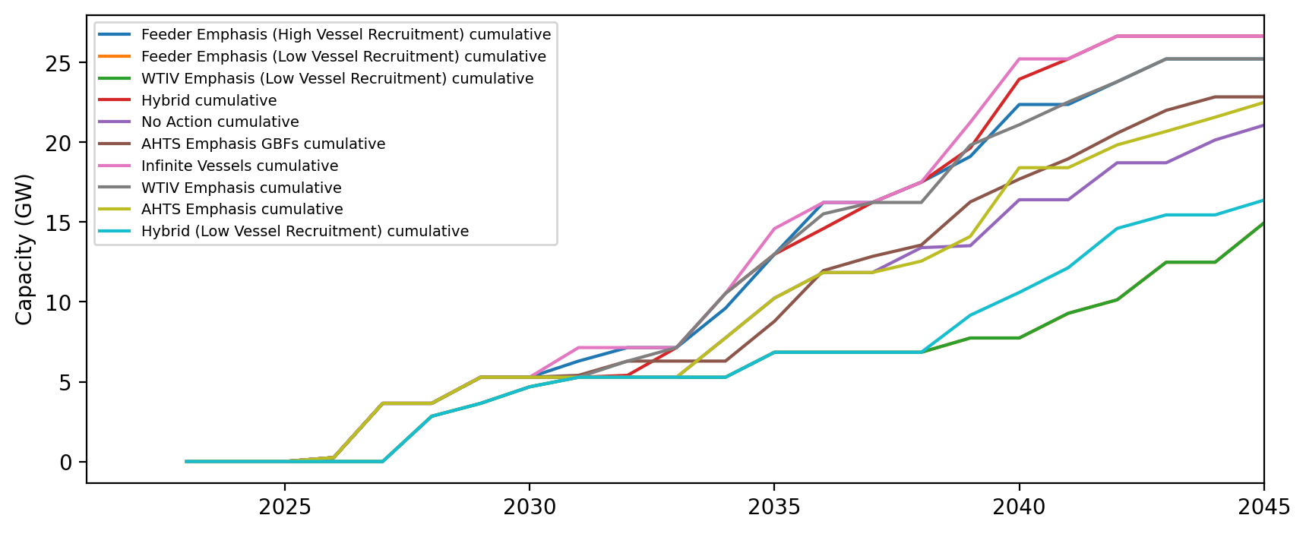
Installed Capacity - Mid-Atlantic

Slide 36
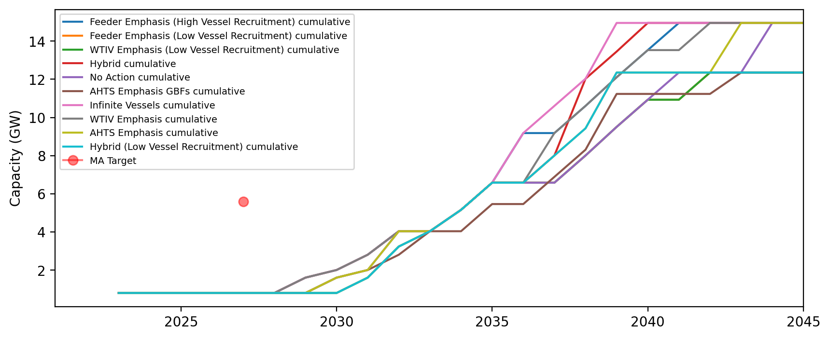
Installed Capacity - MA

Slide 37
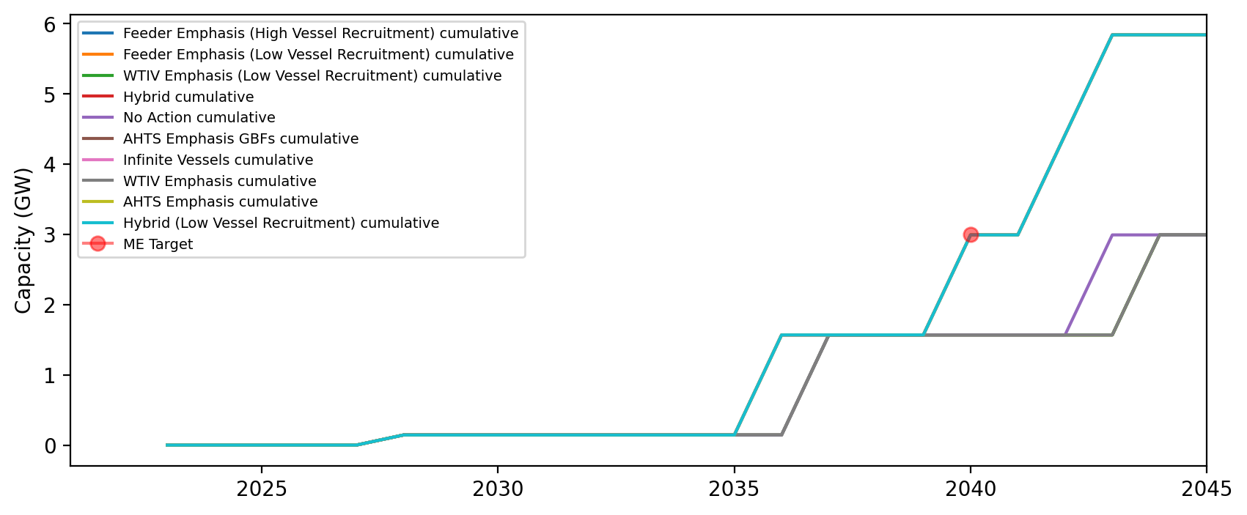
Installed Capacity - ME

Slide 38
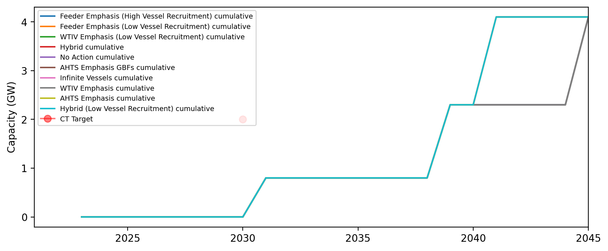
Installed Capacity - CT

Slide 39
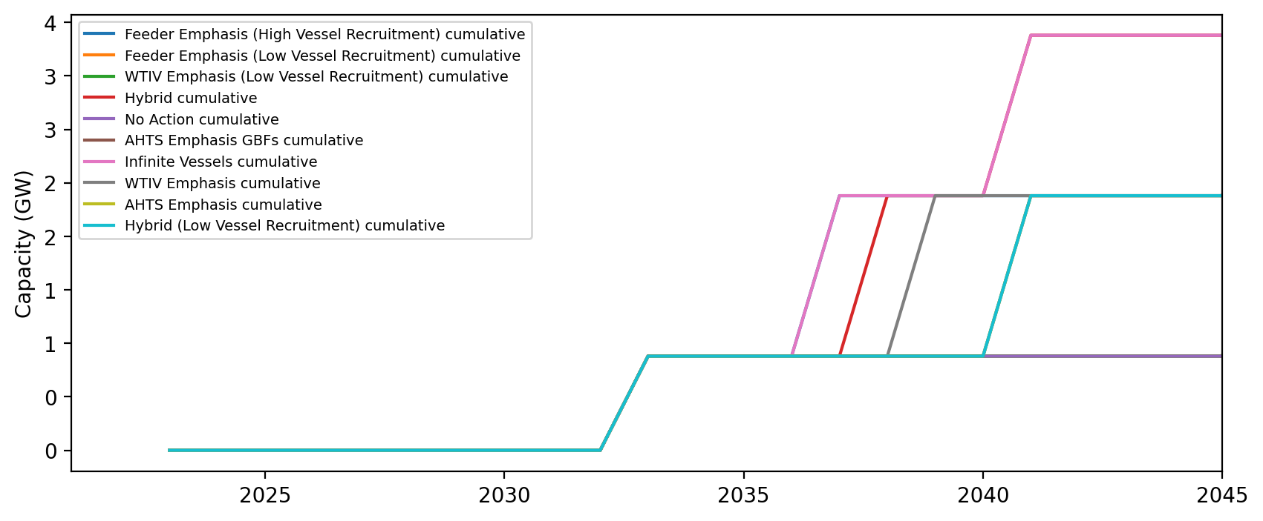
Installed Capacity - RI

Slide 40
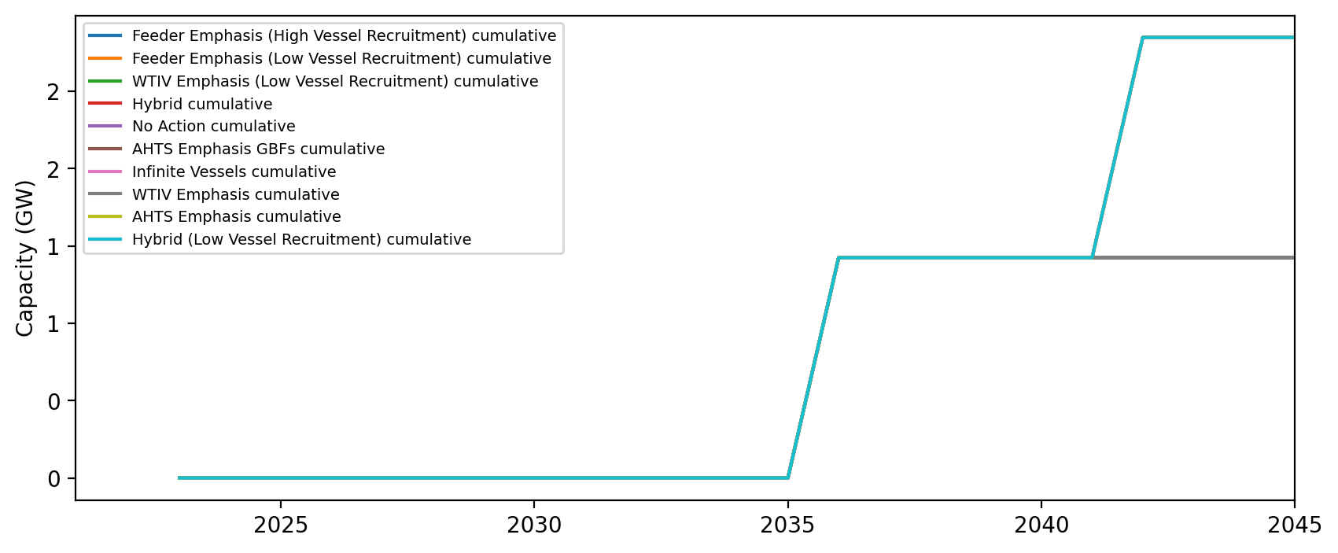
Installed Capacity - NH

Slide 41
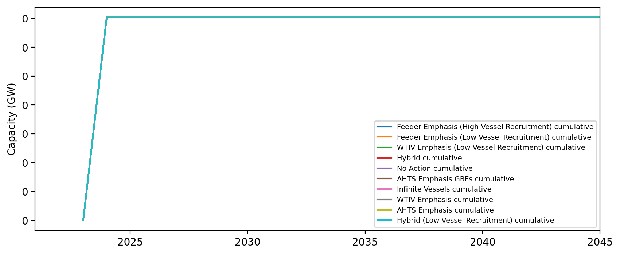
Installed Capacity - RI/CT

Slide 42
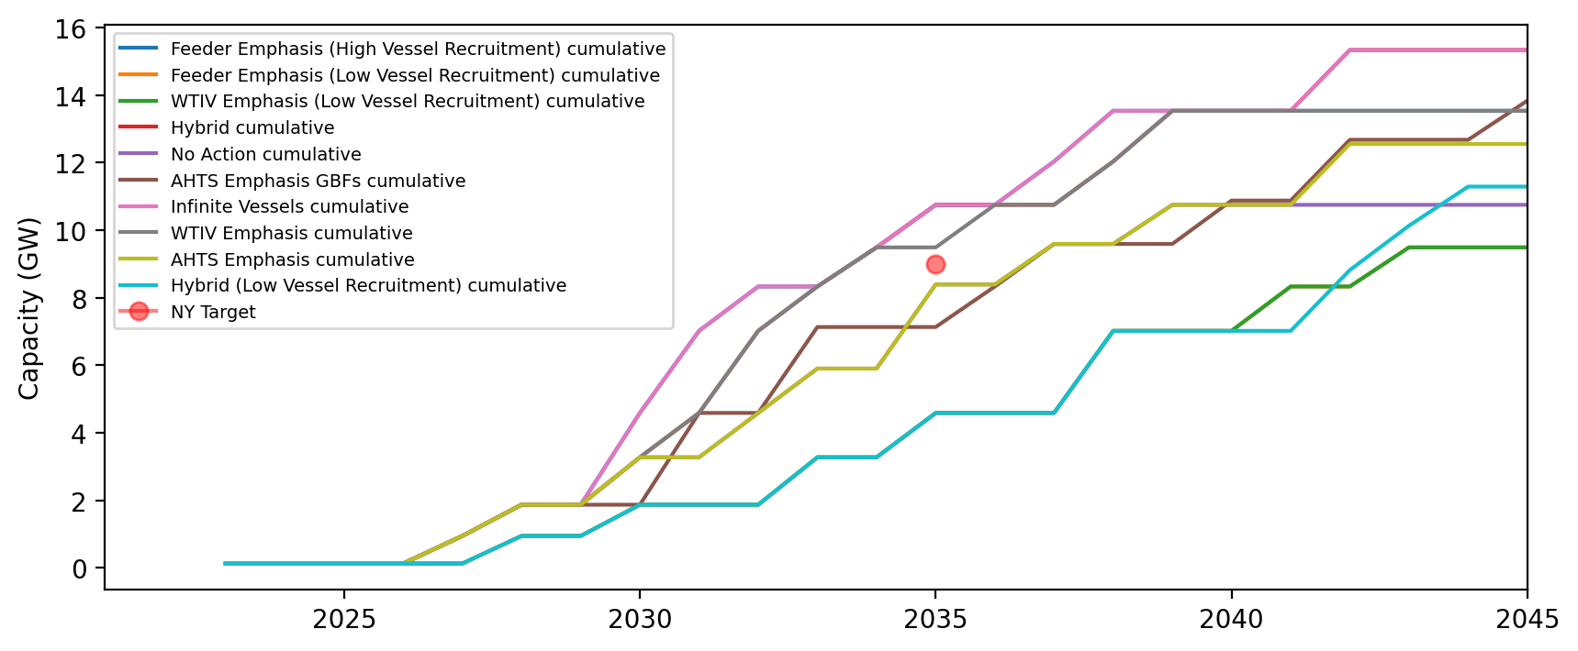
Installed Capacity - NY

Slide 43
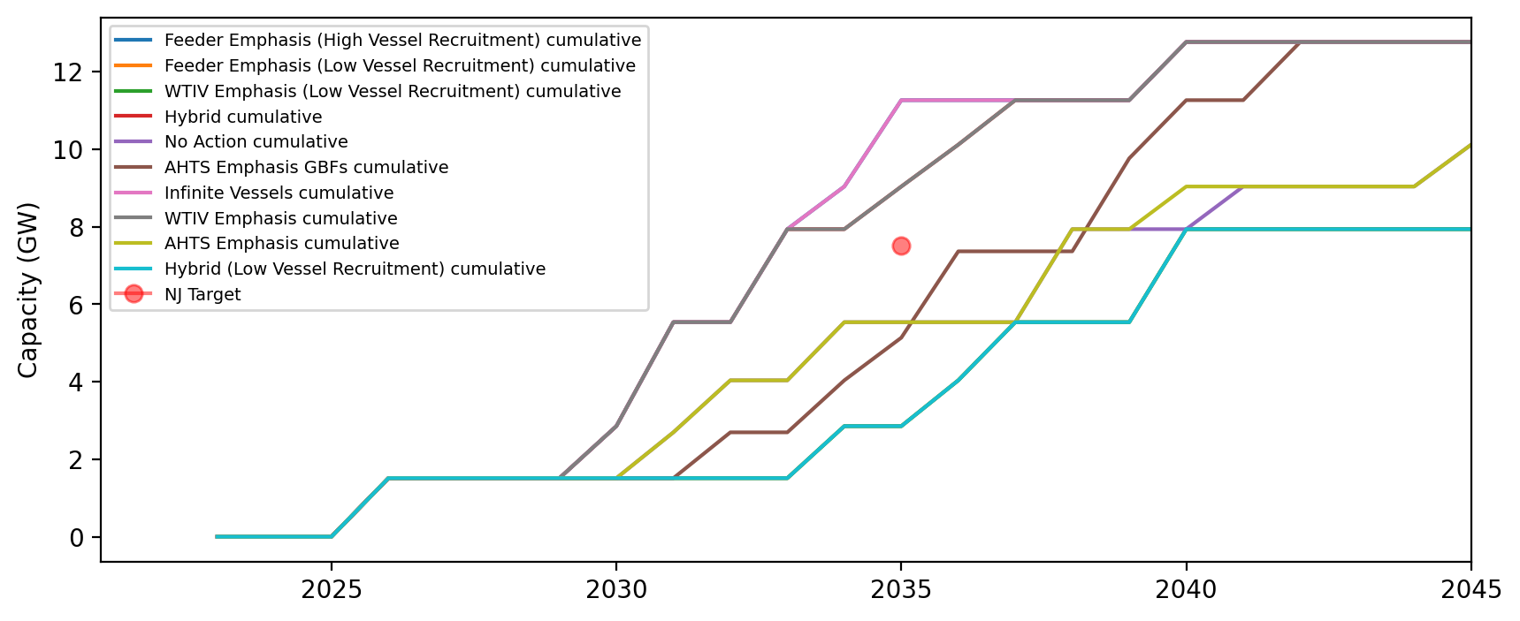
Installed Capacity - NJ

Slide 44
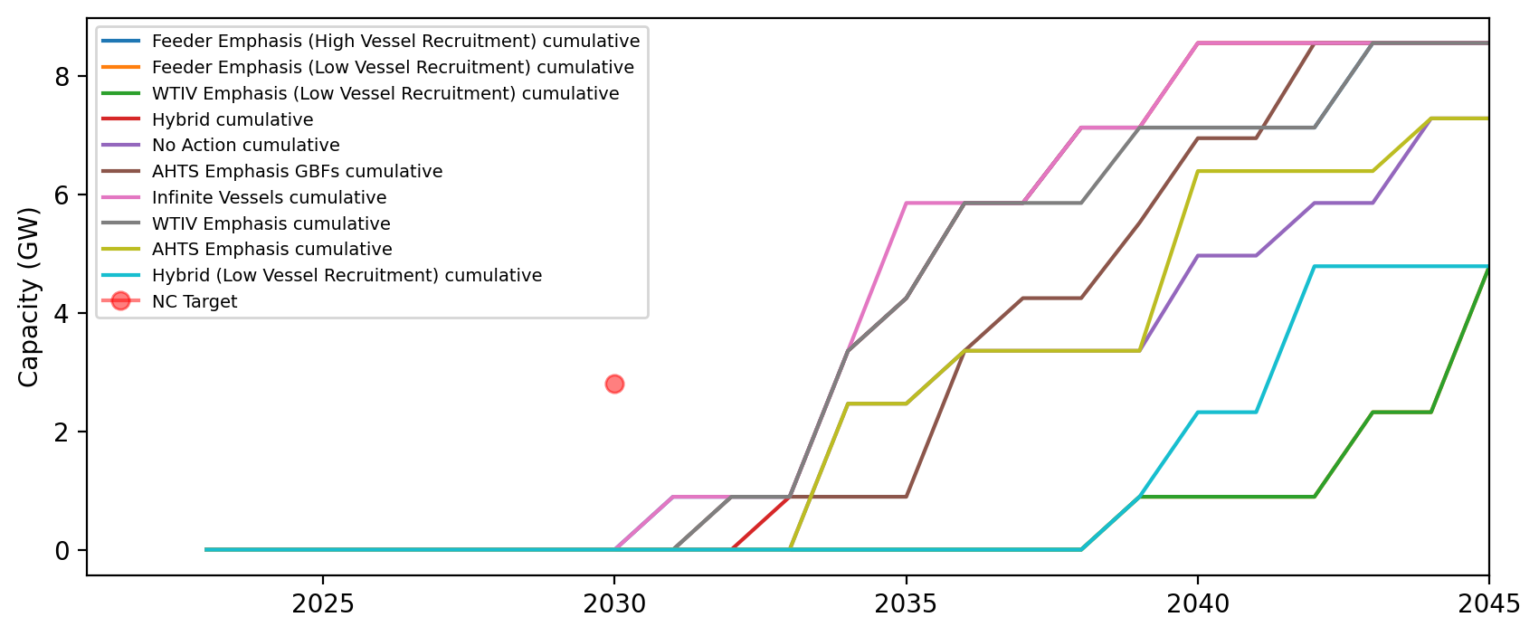
Installed Capacity - NC

Slide 45
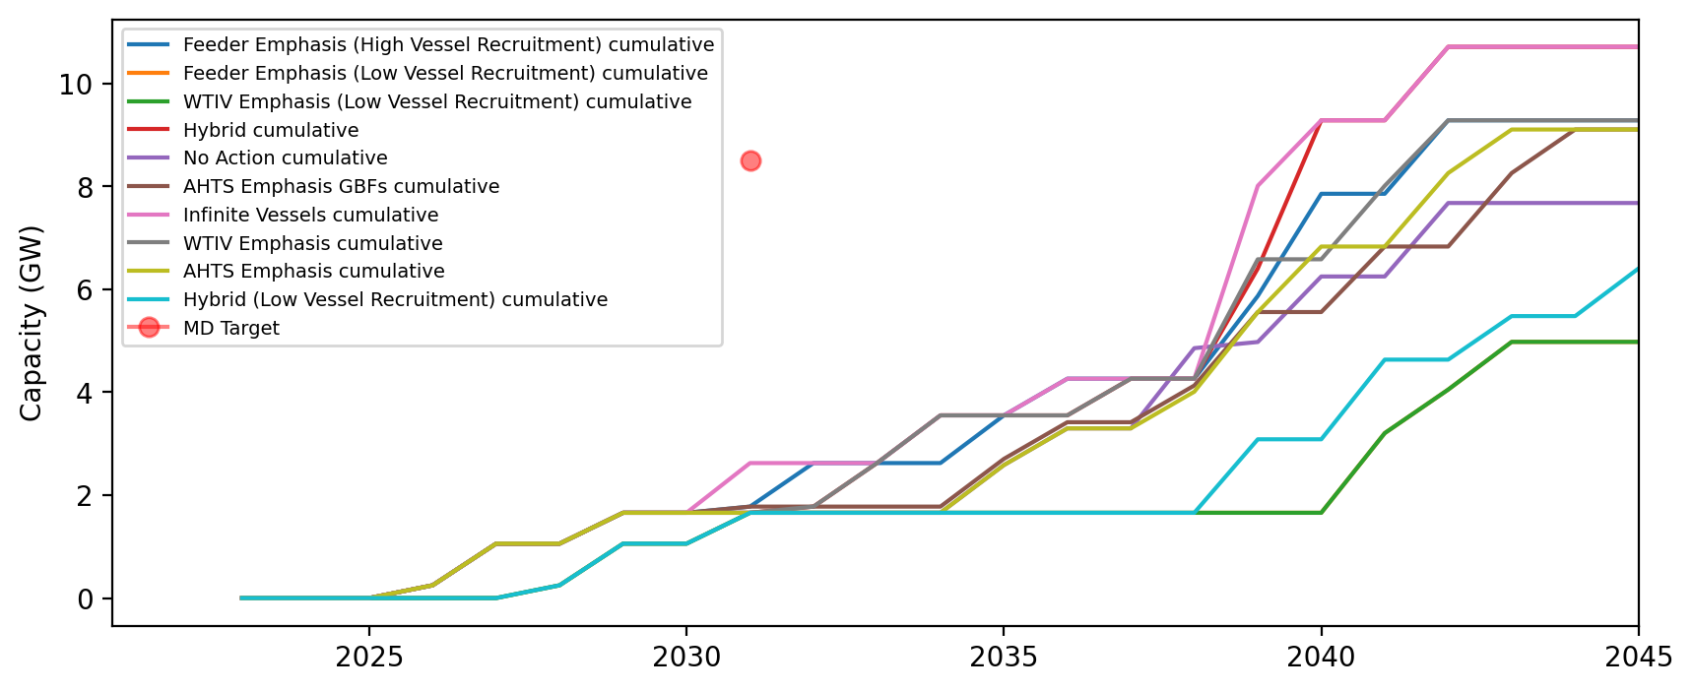
Installed Capacity - MD

Slide 46
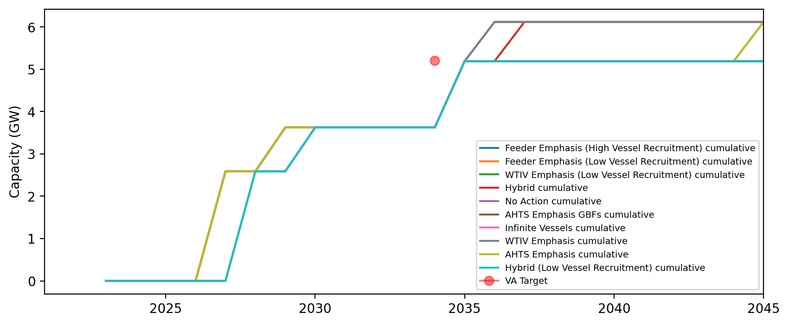
Installed Capacity - VA

Slide 47
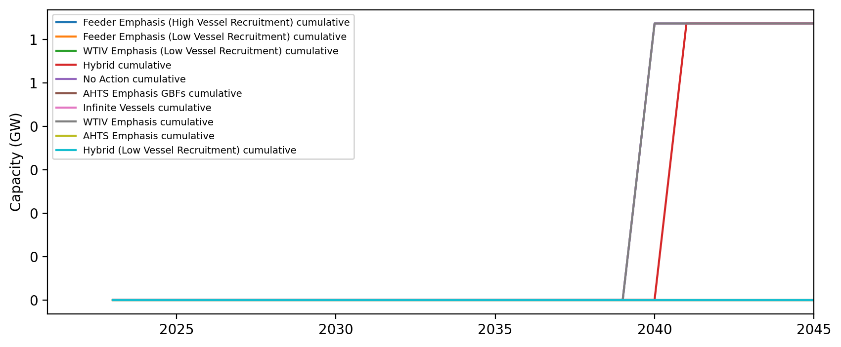
Installed Capacity - DE

Slide 48
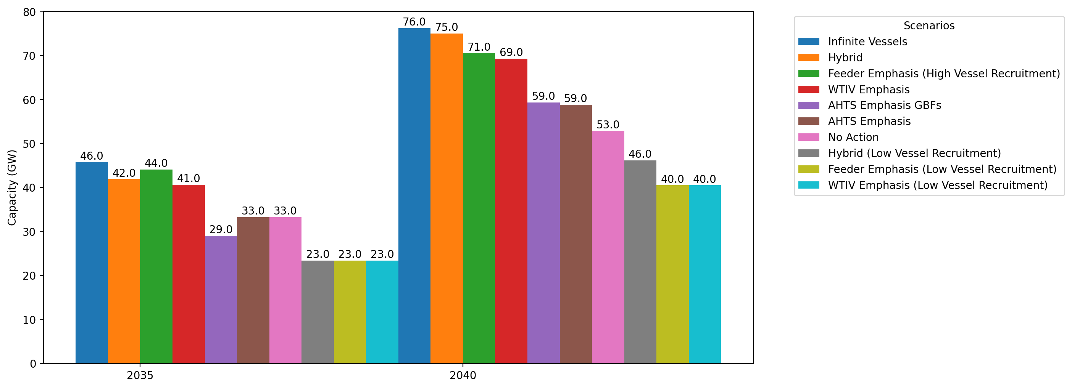
Cumulative Capacity by 2035 and 2040

Slide 49
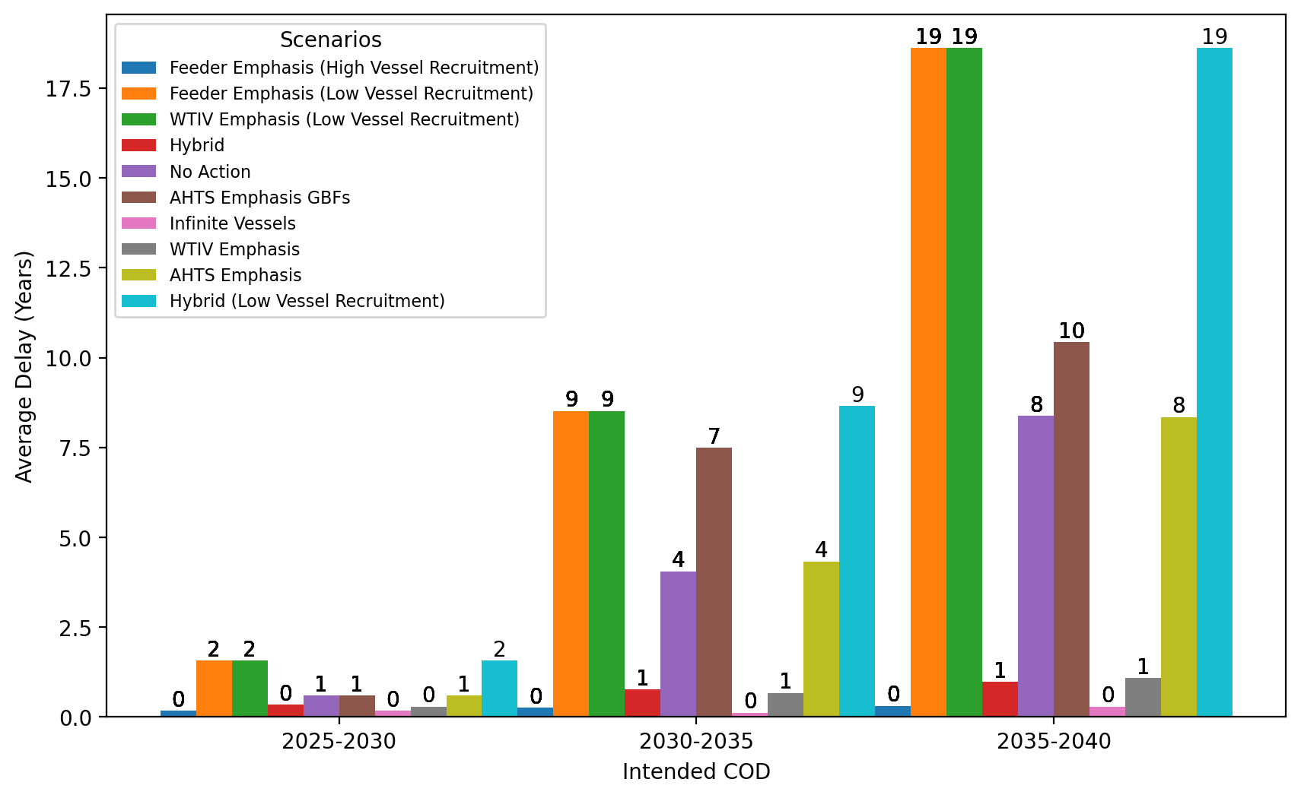
Average Delay Per Project by COD - All Regions

Slide 50
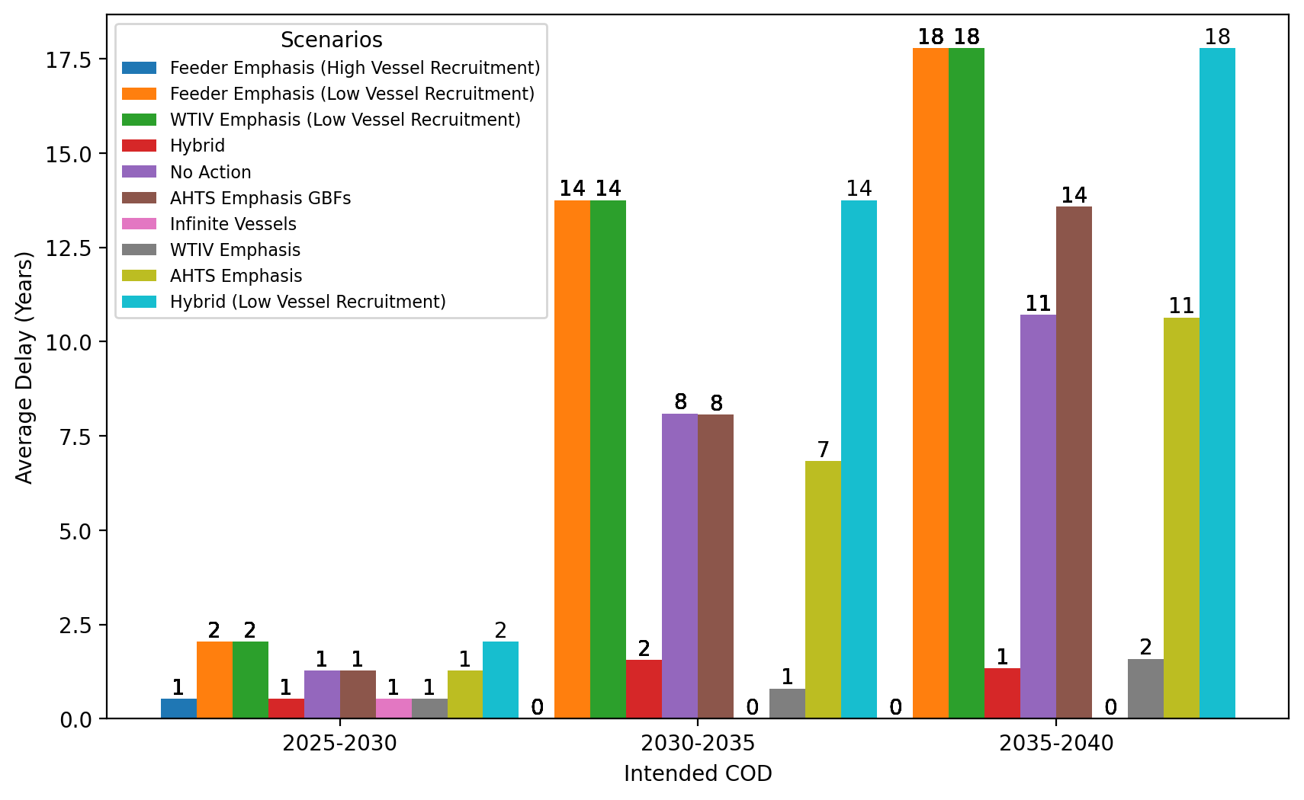
Average Delay Per Project by COD - NE

Slide 51
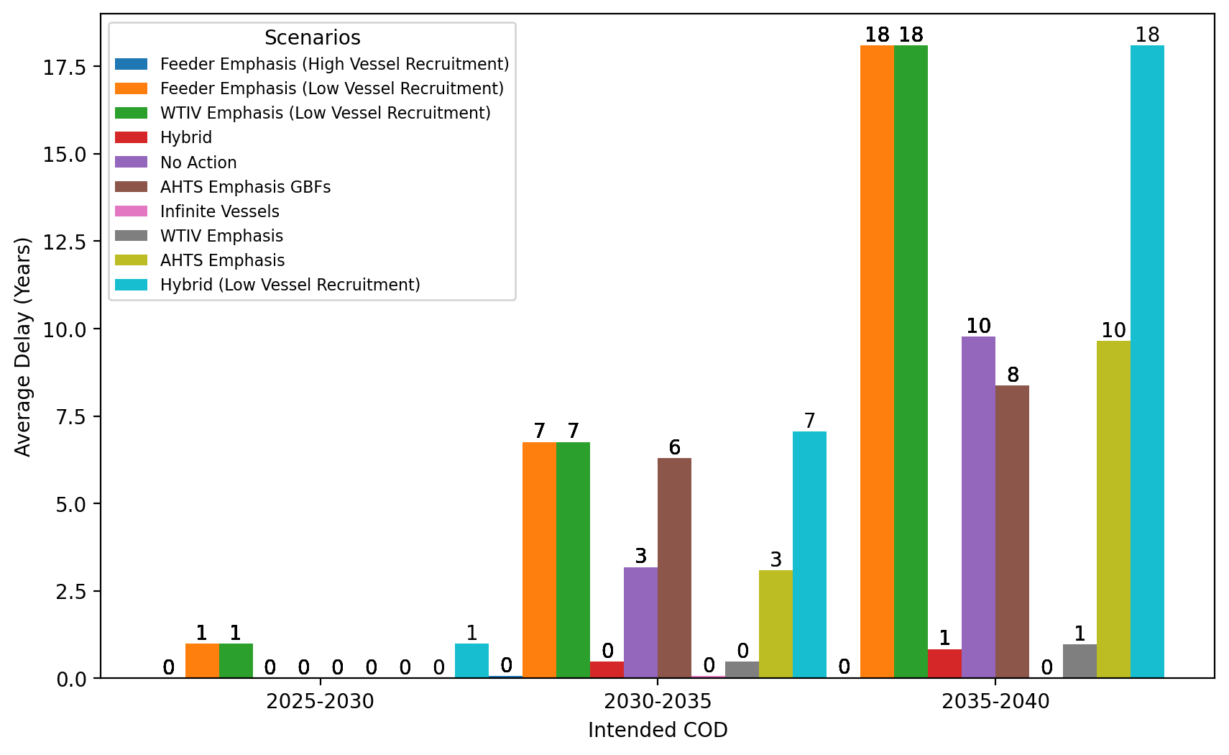
Average Delay Per Project by COD - NYNJ

Slide 52
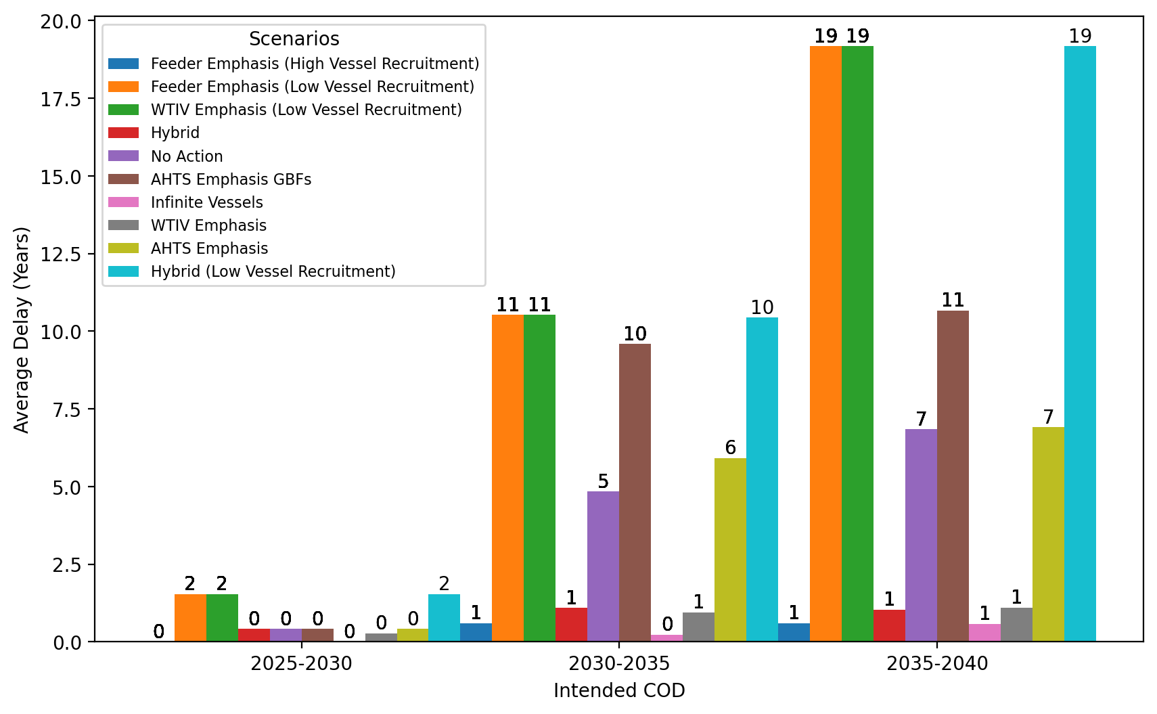
Average Delay Per Project by COD - Mid-Atlantic

Slide 53
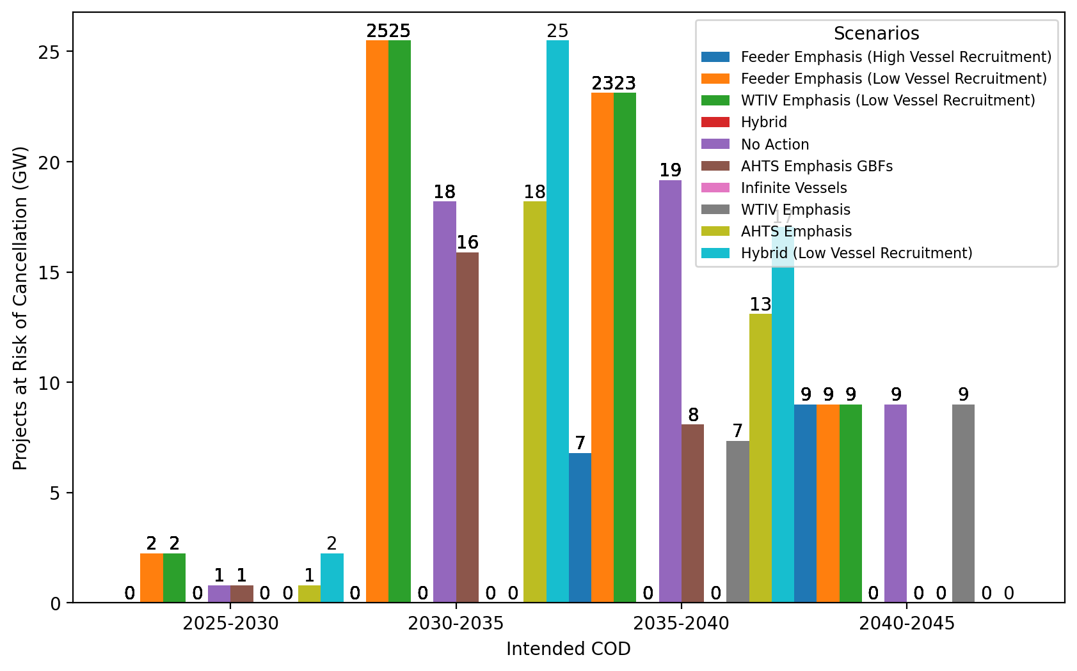
Total Capacity at Risk by COD - All Regions

Slide 54
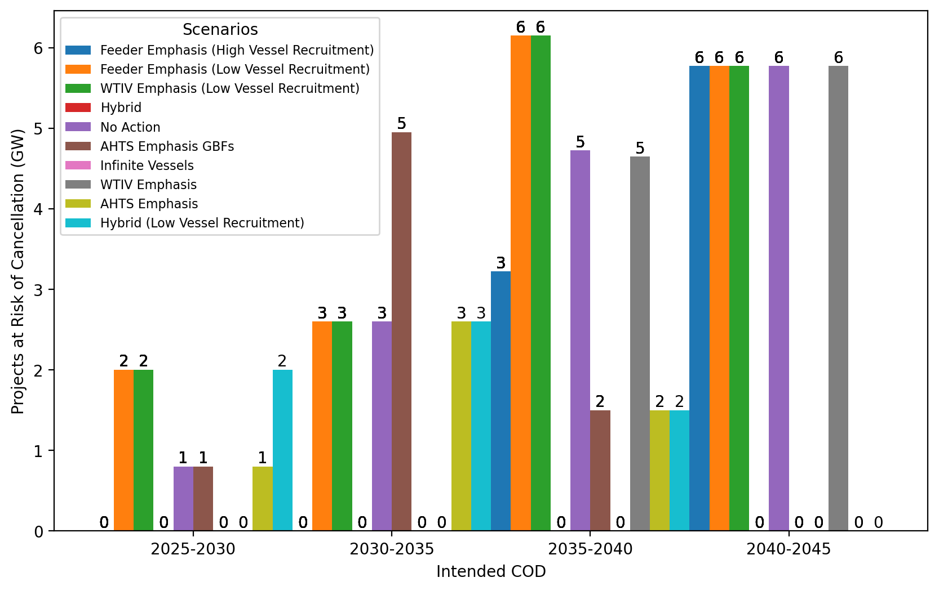
Total Capacity at Risk by COD - NE

Slide 55
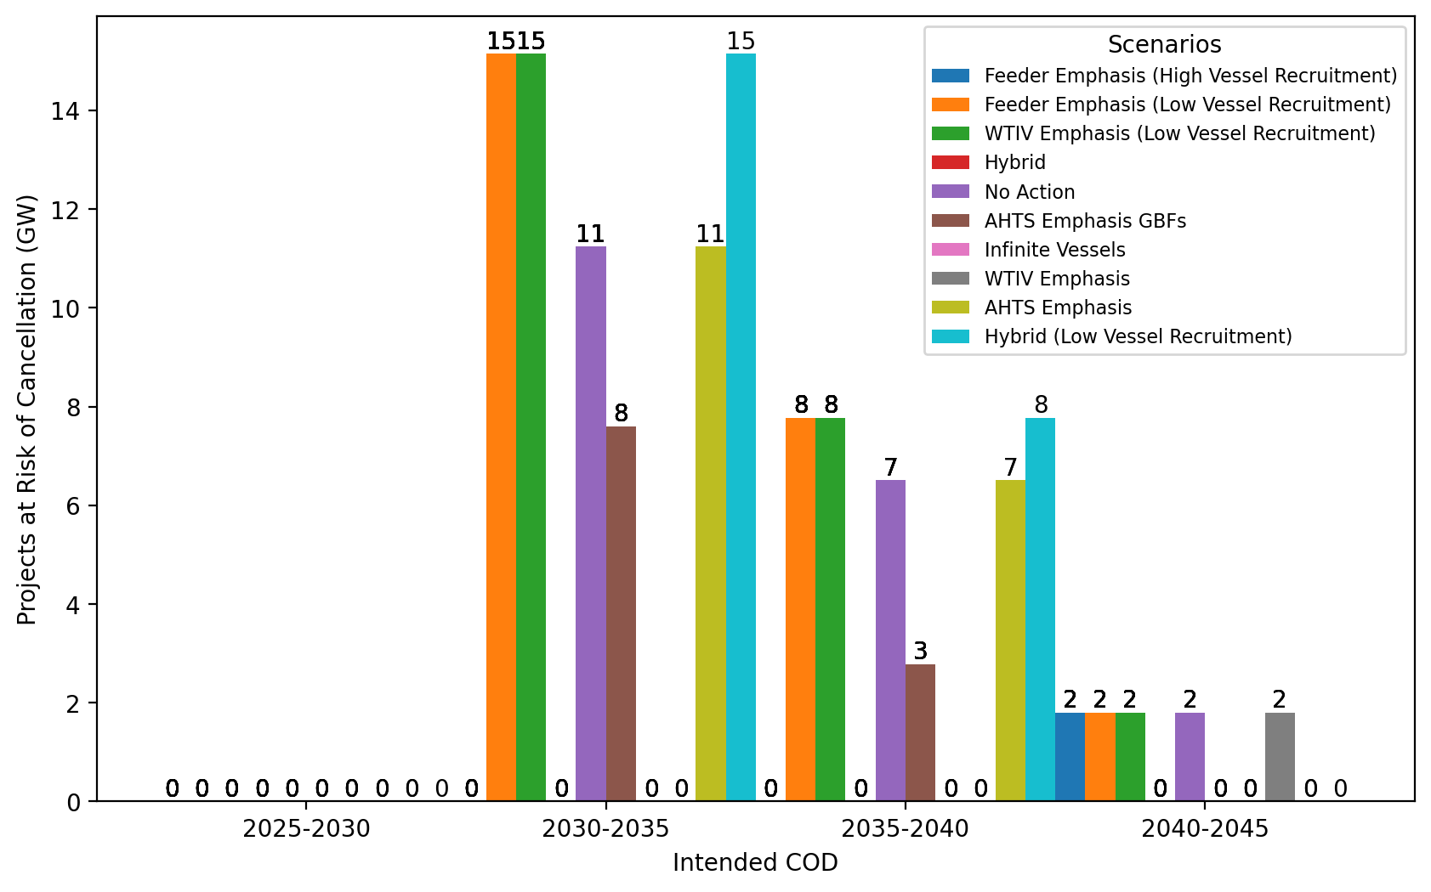
Total Capacity at Risk by COD - NYNJ

Slide 56
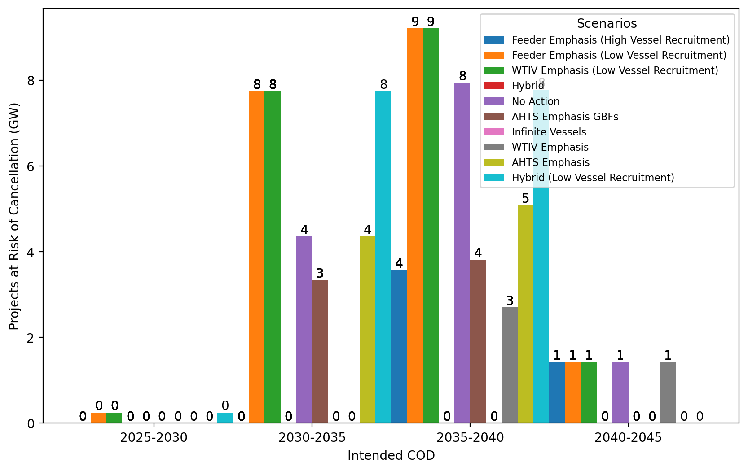
Total Capacity at Risk by COD - Mid-Atlantic

